Slide 1
Reading Group: Asymptotic theory for stationary processes (Wu, 2011)
Heman Leung
Spring, 2020

Slide 2
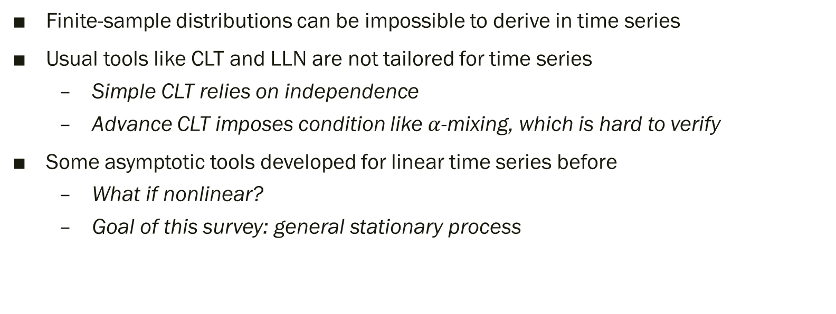
Motivation (p.1)
Finite-sample distributions can be impossible to derive in time series
Usual tools like CLT and LLN are not tailored for time series
Simple CLT relies on independence
Advance CLT imposes condition like $α$-mixing, which is hard to verify
Some asymptotic tools developed for linear time series before
What if nonlinear?
Goal of this survey: general stationary process

Slide 3
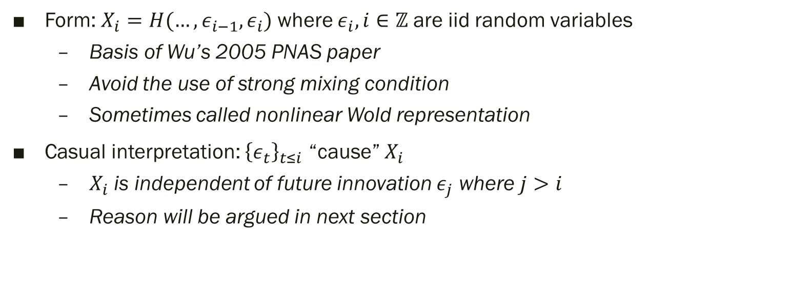
Stationary process
Form: $X_{i}=H(…,ε_{i−1},ε_{i})$ where $ε_{i}, i∈ℤ$ are iid random variables
Basis of Wu’s 2005 PNAS paper
Avoid the use of strong mixing condition
Sometimes called nonlinear Wold representation
Casual interpretation: ${\left\{ε_{t}\right\}}_{t≤i}$ “cause” $X_{i}$
$X_{i}$ is independent of future innovation $ε_{j}$ where $j>i$
Reason will be argued in next section

Slide 4
Representation Theory
Section 2

Slide 5
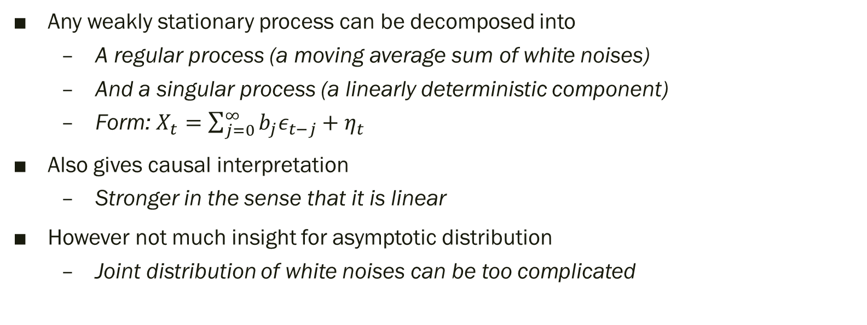
Wold representation (1938) (p.2)
Any weakly stationary process can be decomposed into
A regular process (a moving average sum of white noises)
And a singular process (a linearly deterministic component)
Form: $X_{t}=\sum_{j=0}^{∞}{b_{j}ε_{t−j}}+η_{t}$
Also gives causal interpretation
Stronger in the sense that it is linear
However not much insight for asymptotic distribution
Joint distribution of white noises can be too complicated

Slide 6
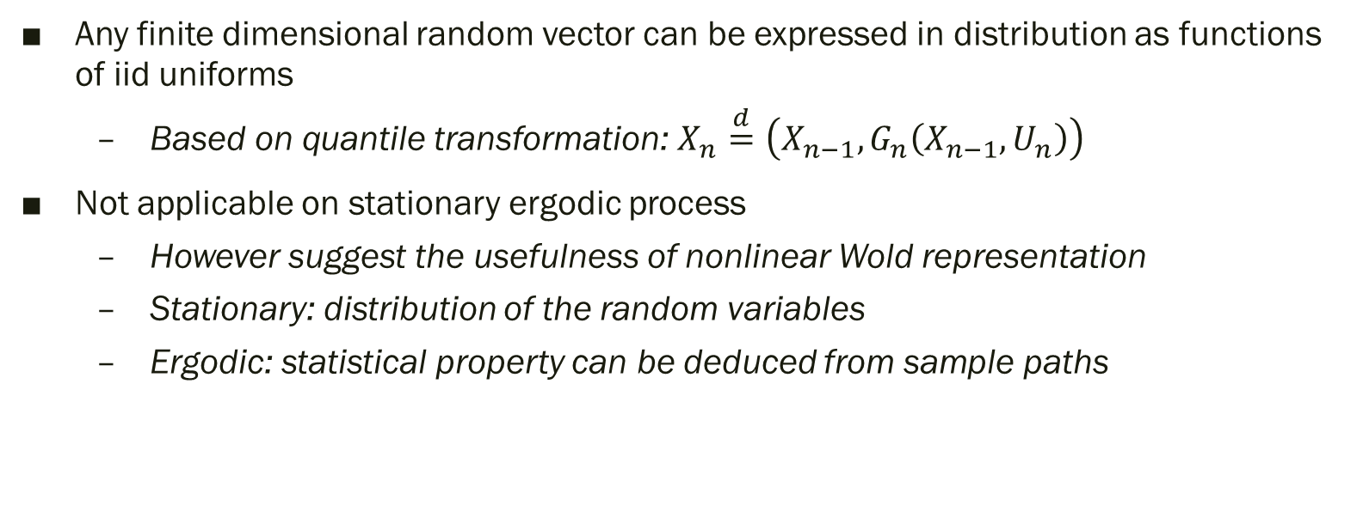
Rosenblatt transformation (1952)
Any finite dimensional random vector can be expressed in distribution as functions of iid uniforms
Based on quantile transformation: $X_{n}\overset{d}{=}\left(X_{n−1}, G_{n}\left(X_{n−1},U_{n}\right)\right)$
Not applicable on stationary ergodic process
However suggest the usefulness of nonlinear Wold representation
Stationary: distribution of the random variables
Ergodic: statistical property can be deduced from sample paths

Slide 7


Comparison
Representation | Form | Requirement | Asymptotic
Wold | $X_{t}=\sum_{j=0}^{∞}{b_{j}ε_{t−j}}+η_{t}$ | Weakly stationary | No
Nonlinear Wold | $X_{t}=H\left(…,ε_{t−1},ε_{t}\right)$ | Strictly stationary | Yes
Weakly stationary $⟺$ Wold
Strictly stationary $⟺$ nonlinear Wold?
Previous example suggest that nonlinear Wold can represent lots of process
Is there strictly stationary process that cannot be represented?
Then we cannot use the asymptotic in this paper

Slide 8
Dependence Measures
Section 3

Slide 9
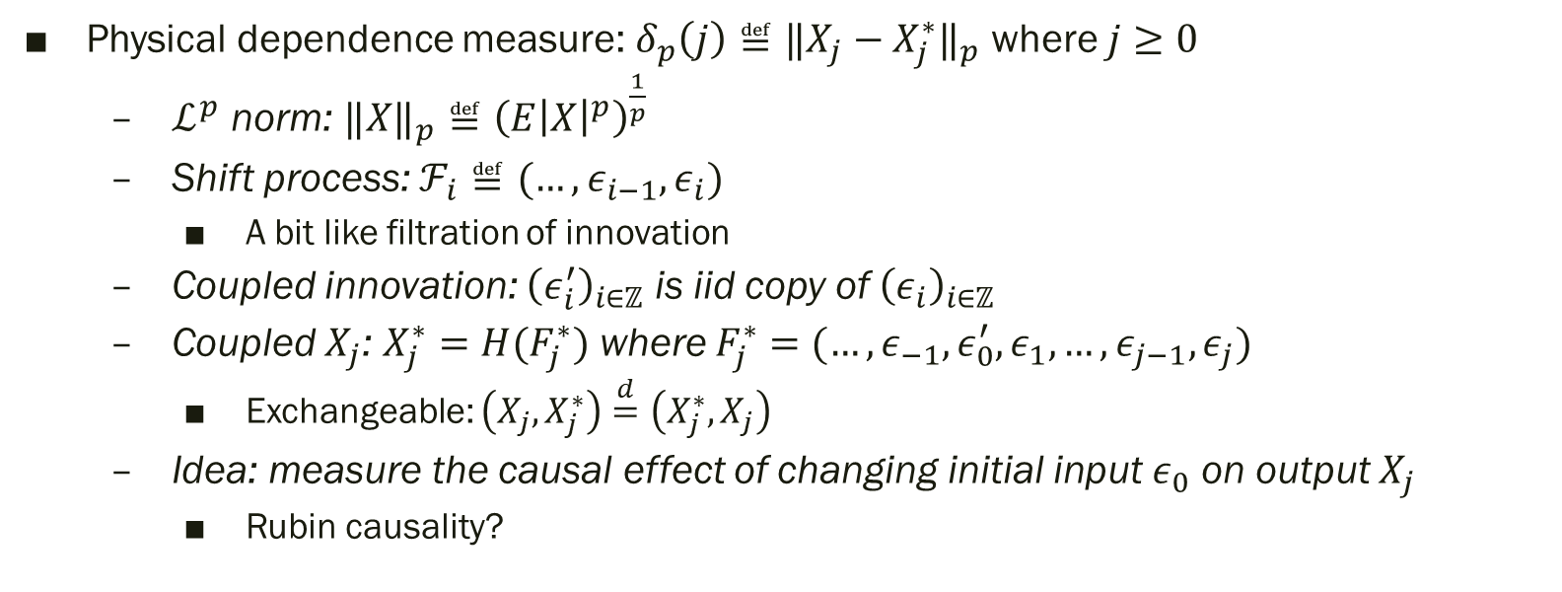
Physical dependence
Physical dependence measure: $δ_{p}\left(j\right)≝{‖X_{j}−X_{j}^{∗}‖}_{p}$ where $j≥0$
$ℒ^{p}$ norm: ${‖X‖}_{p}≝{\left(E{\left|X\right|}^{p}\right)}^{\frac{1}{p}}$
Shift process: $ℱ_{i}≝(…,ε_{i−1},ε_{i})$
A bit like filtration of innovation
Coupled innovation: ${\left(ε_{i}^{′}\right)}_{i∈ℤ}$ is iid copy of ${\left(ε_{i}\right)}_{i∈ℤ}$
Coupled $X_{j}$: $X_{j}^{∗}=H(F_{j}^{∗})$ where $F_{j}^{∗}=(…,ε_{−1},ε_{0}^{′},ε_{1},…,ε_{j−1},ε_{j})$
Exchangeable: $\left(X_{j}, X_{j}^{∗}\right)\overset{d}{=}\left(X_{j}^{∗},X_{j}\right)$
Idea: measure the causal effect of changing initial input $ε_{0}$ on output $X_{j}$
Rubin causality?

Slide 10
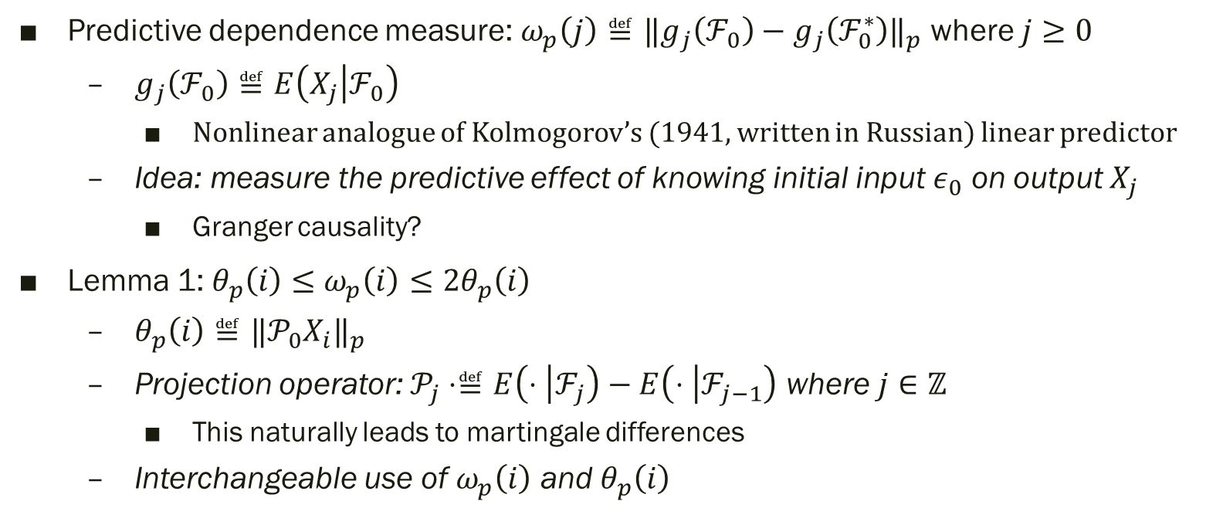
Predictive dependence
Predictive dependence measure: $ω_{p}\left(j\right)≝{‖g_{j}\left(ℱ_{0}\right)−g_{j}\left(ℱ_{0}^{∗}\right)‖}_{p}$ where $j≥0$
$g_{j}\left(ℱ_{0}\right)≝E\left(X_{j} | ℱ_{0}\right)$
Nonlinear analogue of Kolmogorov’s (1941, written in Russian) linear predictor
Idea: measure the predictive effect of knowing initial input $ε_{0}$ on output $X_{j}$
Granger causality?
Lemma 1: $θ_{p}\left(i\right)≤ω_{p}\left(i\right)≤2θ_{p}\left(i\right)$
$θ_{p}\left(i\right)≝{‖𝒫_{0}X_{i}‖}_{p}$
Projection operator: $𝒫_{j}⋅≝E\left(⋅ | ℱ_{j}\right)−E\left(⋅ | ℱ_{j−1}\right)$ where $j∈ℤ$
This naturally leads to martingale differences
Interchangeable use of $ω_{p}\left(i\right)$ and $θ_{p}\left(i\right)$

Slide 11
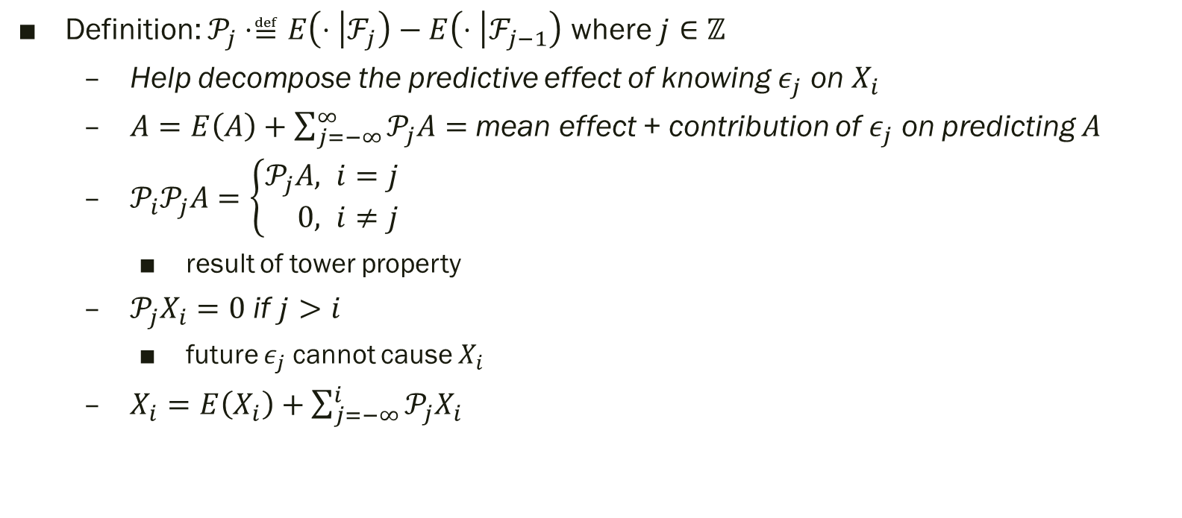
Projection operator
Definition: $𝒫_{j}⋅≝E\left(⋅ | ℱ_{j}\right)−E\left(⋅ | ℱ_{j−1}\right)$ where $j∈ℤ$
Help decompose the predictive effect of knowing $ε_{j}$ on $X_{i}$
$A=E\left(A\right)+\sum_{j=−∞}^{∞}{𝒫_{j}A}=$ mean effect + contribution of $ε_{j}$ on predicting $A$
$𝒫_{i}𝒫_{j}A=\left\{\begin{aligned}𝒫_{j}A&, i=j \\ 0&, i≠j&\end{aligned}\right.$
result of tower property
$𝒫_{j}X_{i}=0$ if $j>i$
future $ε_{j}$ cannot cause $X_{i}$
$X_{i}=E\left(X_{i}\right)+\sum_{j=−∞}^{i}{𝒫_{j}X_{i}}$

Slide 12
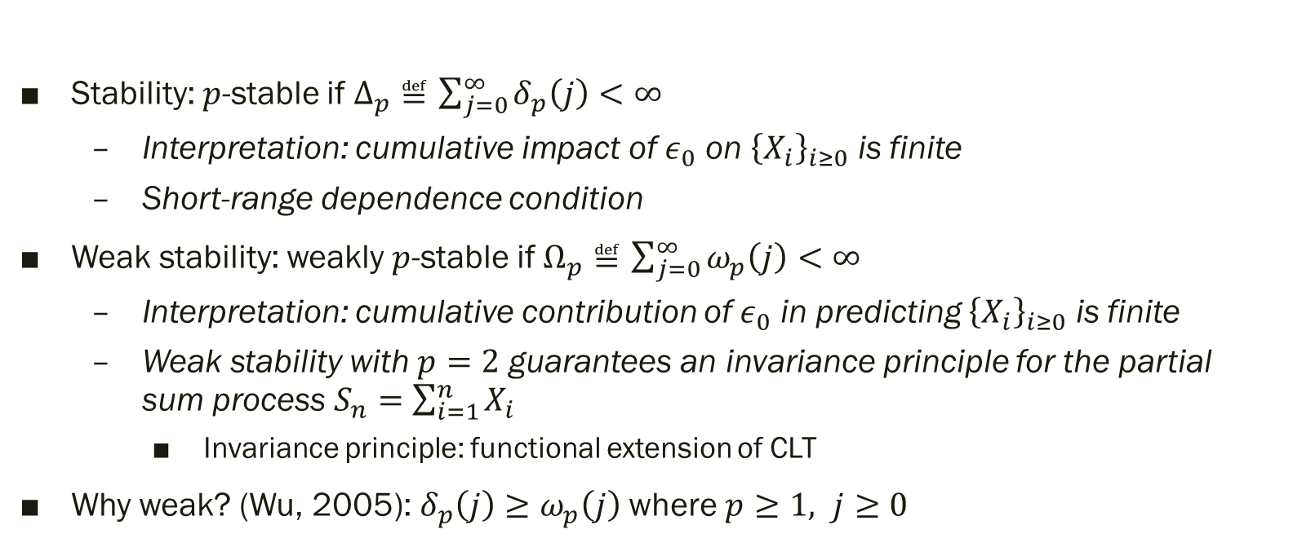
Stability (p.3)
Stability: $p$-stable if $Δ_{p}≝\sum_{j=0}^{∞}{δ_{p}\left(j\right)}<∞$
Interpretation: cumulative impact of $ε_{0}$ on ${\left\{X_{i}\right\}}_{i≥0}$ is finite
Short-range dependence condition
Weak stability: weakly $p$-stable if $Ω_{p}≝\sum_{j=0}^{∞}{ω_{p}\left(j\right)}<∞$
Interpretation: cumulative contribution of $ε_{0}$ in predicting ${\left\{X_{i}\right\}}_{i≥0}$ is finite
Weak stability with $p=2$ guarantees an invariance principle for the partial sum process $S_{n}=\sum_{i=1}^{n}{X_{i}}$
Invariance principle: functional extension of CLT
Why weak? (Wu, 2005):$δ_{p}\left(j\right)≥ω_{p}\left(j\right)$ where $p≥1, j≥0$

Slide 13
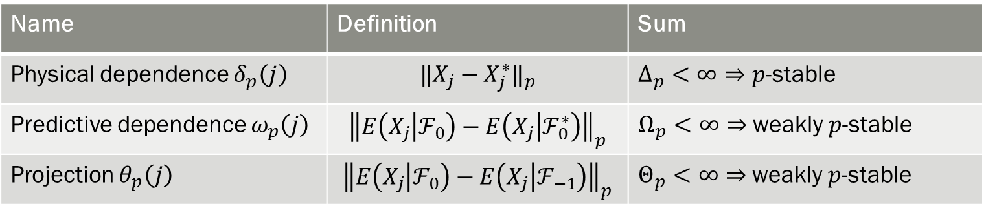

Relationship
Note that definitions in Wu (2005) are used instead
$θ_{p}\left(j\right)≤ω_{p}\left(j\right)≤\min\left[2θ_{p}\left(j\right),δ_{p}\left(j\right)\right]$
$Δ_{p}<∞⇒Θ_{p}≤Ω_{p}<∞$ (stability implies weak stability)
Name | Definition | Sum
Physical dependence $δ_{p}\left(j\right)$ | $${‖X_{j}−X_{j}^{∗}‖}_{p}$$ | $Δ_{p}<∞⇒p$-stable
Predictive dependence $ω_{p}\left(j\right)$ | $${\left\|E\left(X_{j} | ℱ_{0}\right)−E\left(X_{j} | ℱ_{0}^{∗}\right)\right\|}_{p}$$ | $Ω_{p}<∞⇒$ weakly $p$-stable
Projection $θ_{p}\left(j\right)$ | $${\left\|E\left(X_{j} | ℱ_{0}\right)−E\left(X_{j} | ℱ_{−1}\right)\right\|}_{p}$$ | $Θ_{p}<∞⇒$ weakly $p$-stable

Slide 14
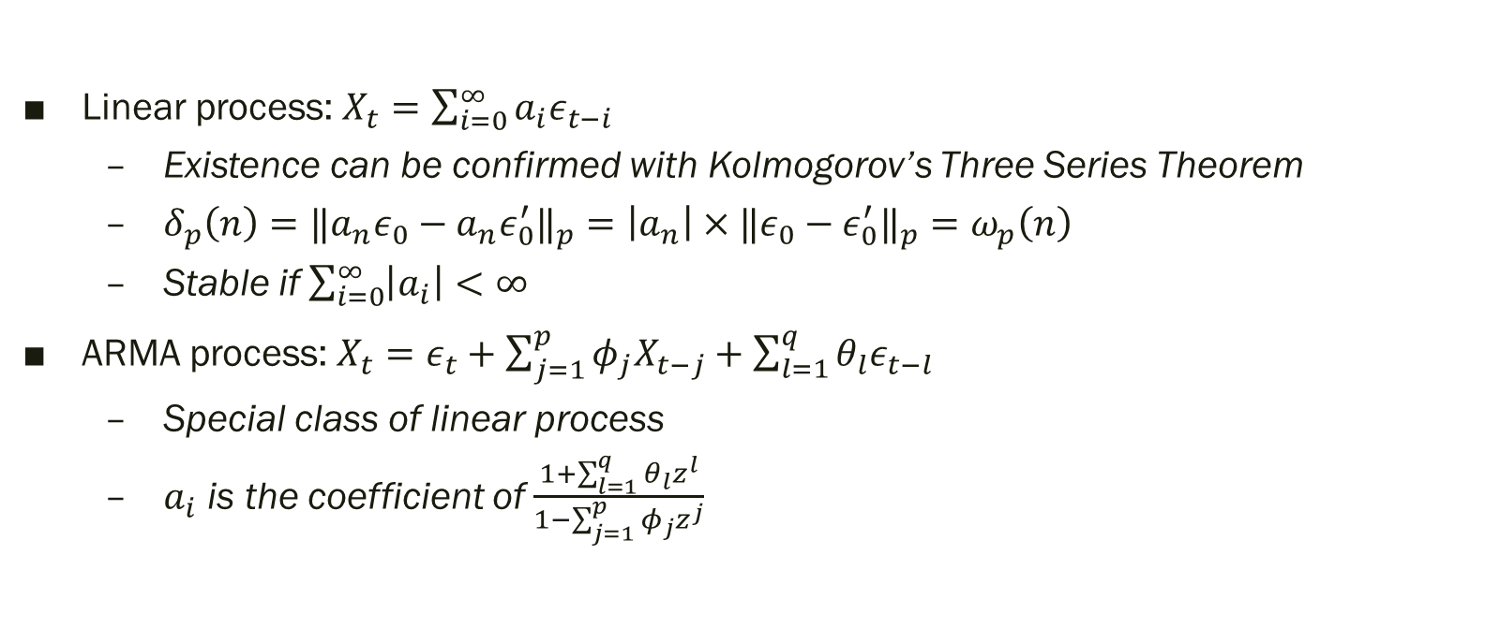
Examples (p.4)
Linear process: $X_{t}=\sum_{i=0}^{∞}{a_{i}ε_{t−i}}$
Existence can be confirmed with Kolmogorov’s Three Series Theorem
$δ_{p}\left(n\right)={‖a_{n}ε_{0}−a_{n}ε_{0}^{′}‖}_{p}=\left|a_{n}\right|×{‖ε_{0}−ε_{0}^{′}‖}_{p}=ω_{p}\left(n\right)$
Stable if $\sum_{i=0}^{∞}{\left|a_{i}\right|}<∞$
ARMA process: $X_{t}=ε_{t}+\sum_{j=1}^{p}{φ_{j}X_{t−j}}+\sum_{l=1}^{q}{θ_{l}ε_{t−l}}$
Special class of linear process
$a_{i}$ is the coefficient of $\frac{1+\sum_{l=1}^{q}{θ_{l}z^{l}}}{1−\sum_{j=1}^{p}{φ_{j}z^{j}}}$

Slide 15
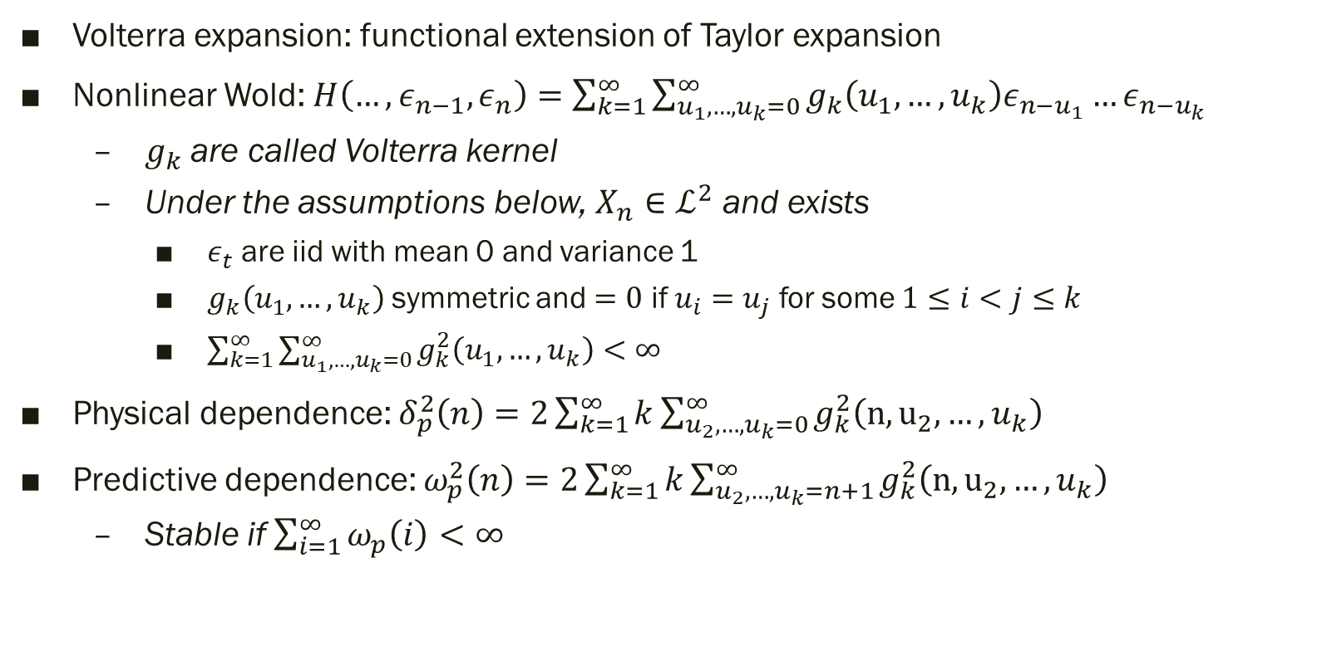
Volterra series
Volterra expansion: functional extension of Taylor expansion
Nonlinear Wold: $H\left(…,ε_{n−1},ε_{n}\right)=\sum_{k=1}^{∞}{\sum_{u_{1},…,u_{k}=0}^{∞}{g_{k}\left(u_{1},…,u_{k}\right)ε_{n−u_{1}}…ε_{n−u_{k}}}}$
$g_{k}$ are called Volterra kernel
Under the assumptions below, $X_{n}∈ℒ^{2}$ and exists
$ε_{t}$ are iid with mean 0 and variance 1
$g_{k}\left(u_{1},…,u_{k}\right)$ symmetric and $=0$ if $u_{i}=u_{j}$ for some $1≤i<j≤k$
$\sum_{k=1}^{∞}{\sum_{u_{1},…,u_{k}=0}^{∞}{g_{k}^{2}\left(u_{1},…,u_{k}\right)}}<∞$
Physical dependence: $δ_{p}^{2}\left(n\right)=2\sum_{k=1}^{∞}{k\sum_{u_{2},…,u_{k}=0}^{∞}{g_{k}^{2}\left(n,u_{2},…,u_{k}\right)}}$
Predictive dependence: $ω_{p}^{2}\left(n\right)=2\sum_{k=1}^{∞}{k\sum_{u_{2},…,u_{k}=n+1}^{∞}{g_{k}^{2}\left(n,u_{2},…,u_{k}\right)}}$
Stable if $\sum_{i=1}^{∞}{ω_{p}\left(i\right)}<∞$

Slide 16
Nonlinear time series
Section 4

Slide 17
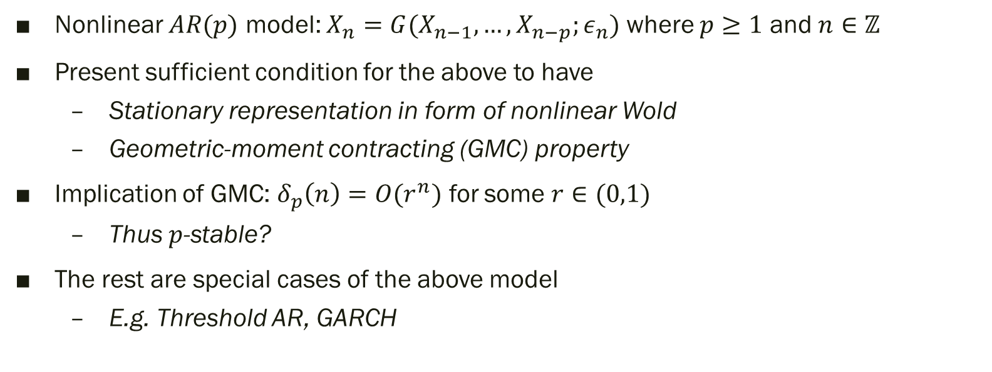
Summary (p.4-7)
Nonlinear $AR(p)$ model: $X_{n}=G(X_{n−1},…, X_{n−p};ε_{n})$ where $p≥1$ and $n∈ℤ$
Present sufficient condition for the above to have
Stationary representation in form of nonlinear Wold
Geometric-moment contracting (GMC) property
Implication of GMC: $δ_{p}\left(n\right)=O(r^{n})$ for some $r∈(0,1)$
Thus $p$-stable?
The rest are special cases of the above model
E.g. Threshold AR, GARCH

Slide 18
Central limit theory
Section 5

Slide 19
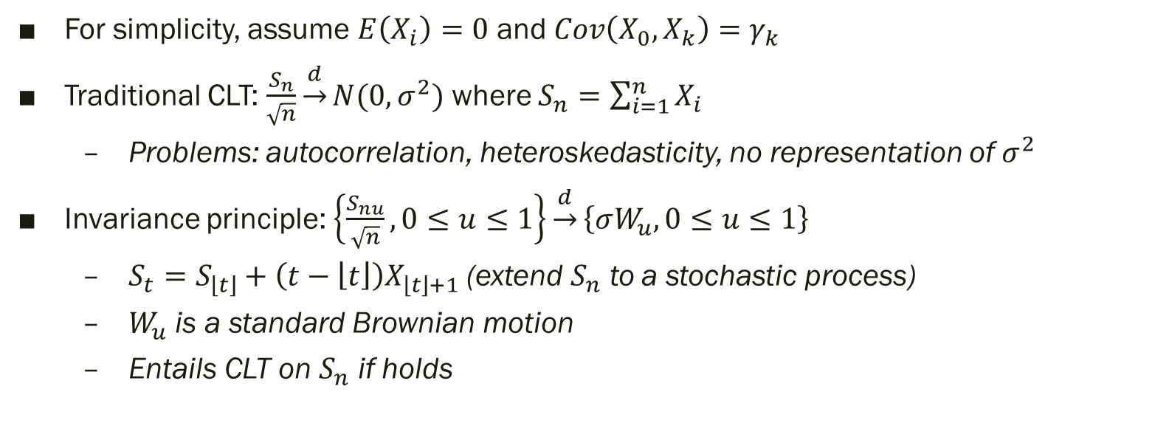
Invariance principle (p.7-8)
For simplicity, assume $E\left(X_{i}\right)=0$ and $Cov\left(X_{0},X_{k}\right)=γ_{k}$
Traditional CLT: $\frac{S_{n}}{\sqrt{n}}\underset{→}{d}N(0,σ^{2})$ where $S_{n}=\sum_{i=1}^{n}{X_{i}}$
Problems: autocorrelation, heteroskedasticity, no representation of $σ^{2}$
Invariance principle: $\left\{\frac{S_{nu}}{\sqrt{n}},0≤u≤1\right\}\underset{→}{d}\left\{σW_{u},0≤u≤1\right\}$
$S_{t}=S_{\left\lfloor t\right\rfloor }+\left(t−\left\lfloor t\right\rfloor \right)X_{\left\lfloor t\right\rfloor +1}$ (extend $S_{n}$ to a stochastic process)
$W_{u}$ is a standard Brownian motion
Entails CLT on $S_{n}$ if holds

Slide 20
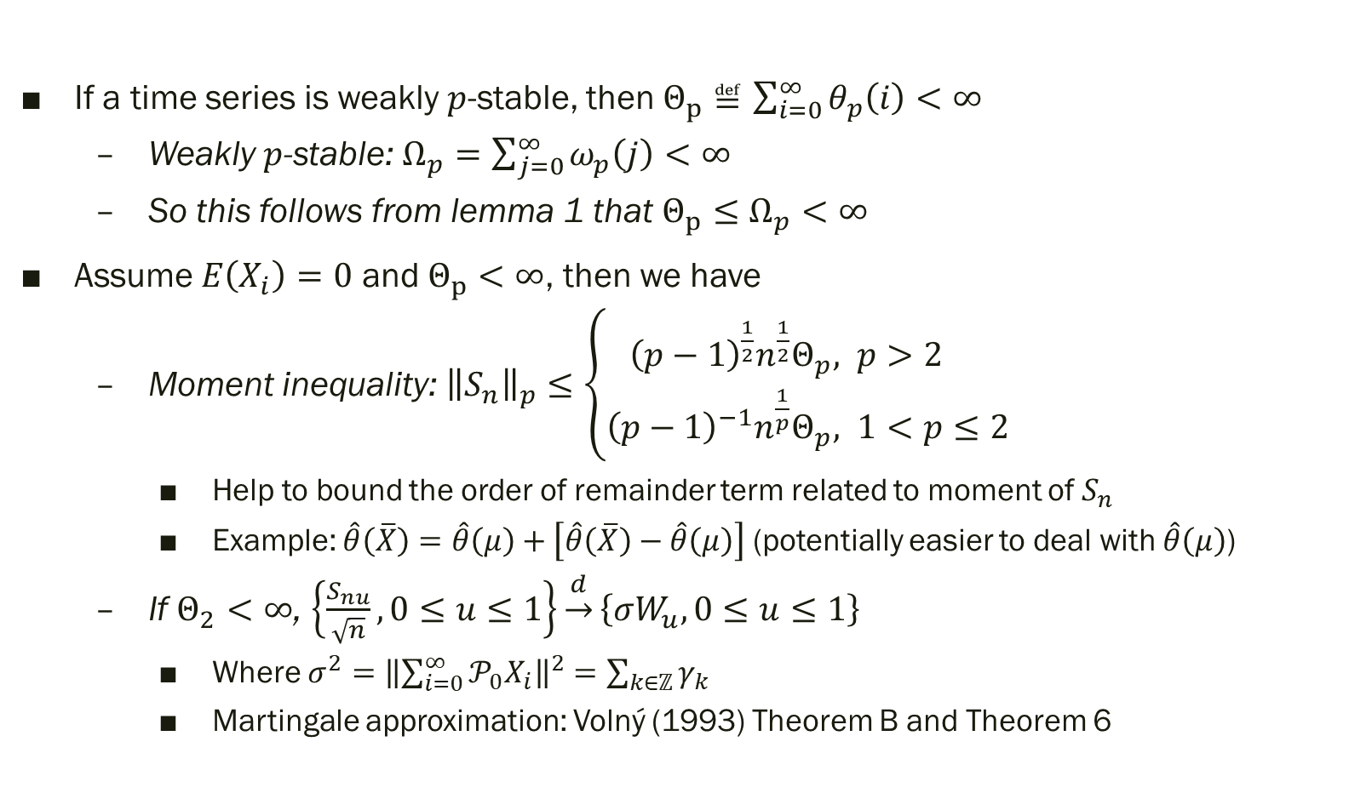
Weak stability (p.8)
If a time series is weakly $p$-stable, then $Θ_{p}≝\sum_{i=0}^{∞}{θ_{p}\left(i\right)}<∞$
Weakly $p$-stable: $Ω_{p}=\sum_{j=0}^{∞}{ω_{p}\left(j\right)}<∞$
So this follows from lemma 1 that $Θ_{p}≤Ω_{p}<∞$
Assume $E\left(X_{i}\right)=0$ and $Θ_{p}<∞$, then we have
Moment inequality: ${\left\|S_{n}\right\|}_{p}≤\left\{\begin{aligned}{\left(p−1\right)}^{\frac{1}{2}}n^{\frac{1}{2}}Θ_{p}&, p>2 \\ {\left(p−1\right)}^{−1}n^{\frac{1}{p}}Θ_{p}&, 1<p≤2\end{aligned}\right.$
Help to bound the order of remainder term related to moment of $S_{n}$
Example: $\hat{θ}\left(\overline{X}\right)=\hat{θ}\left(μ\right)+\left[\hat{θ}\left(\overline{X}\right)−\hat{θ}\left(μ\right)\right]$ (potentially easier to deal with $\hat{θ}\left(μ\right)$)
If $Θ_{2}<∞$, $\left\{\frac{S_{nu}}{\sqrt{n}},0≤u≤1\right\}\underset{→}{d}\left\{σW_{u},0≤u≤1\right\}$
Where $σ^{2}={\left\|\sum_{i=0}^{∞}{𝒫_{0}X_{i}}\right\|}^{2}=\sum_{k∈ℤ}{γ_{k}}$
Martingale approximation: Volný (1993) Theorem B and Theorem 6

Slide 21
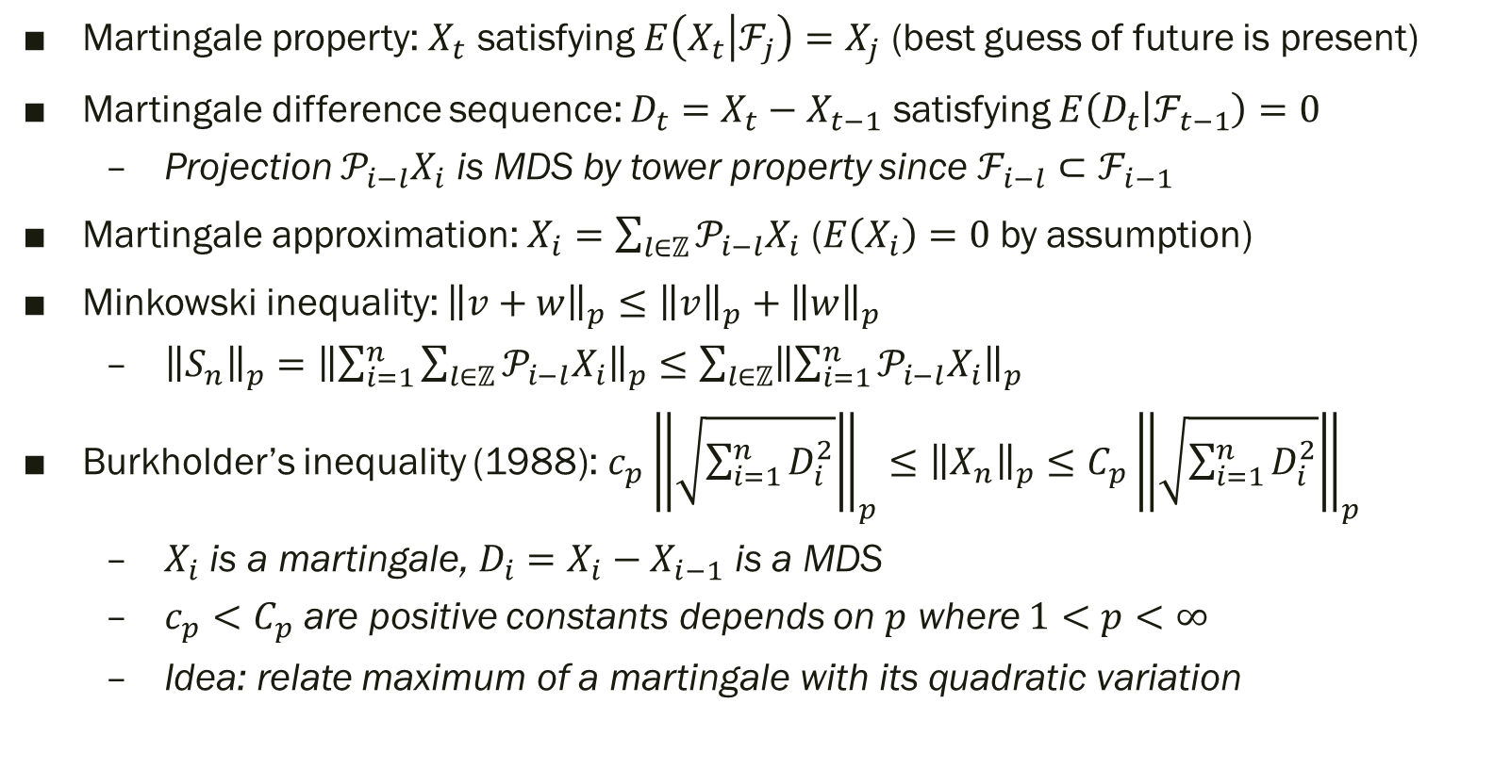
Martingale approximation
Martingale property: $X_{t}$ satisfying $E\left(X_{t} | ℱ_{j}\right)=X_{j}$ (best guess of future is present)
Martingale difference sequence: $D_{t}=X_{t}−X_{t−1}$ satisfying $E\left(D_{t} | ℱ_{t−1}\right)=0$
Projection $𝒫_{i−l}X_{i}$ is MDS by tower property since $ℱ_{i−l}⊂ℱ_{i−1}$
Martingale approximation: $X_{i}=\sum_{l∈ℤ}{𝒫_{i−l}X_{i}}$ ($E\left(X_{i}\right)=0$ by assumption)
Minkowski inequality: ${\left\|v+w\right\|}_{p}≤{\left\|v\right\|}_{p}+{\left\|w\right\|}_{p}$
${\left\|S_{n}\right\|}_{p}={\left\|\sum_{i=1}^{n}{\sum_{l∈ℤ}{𝒫_{i−l}X_{i}}}\right\|}_{p}≤\sum_{l∈ℤ}{{\left\|\sum_{i=1}^{n}{𝒫_{i−l}X_{i}}\right\|}_{p}}$
Burkholder’s inequality (1988): $c_{p}{\left\|\sqrt{\sum_{i=1}^{n}{D_{i}^{2}}}\right\|}_{p}≤{\left\|X_{n}\right\|}_{p}≤C_{p}{\left\|\sqrt{\sum_{i=1}^{n}{D_{i}^{2}}}\right\|}_{p}$
$X_{i}$ is a martingale, $D_{i}=X_{i}−X_{i−1}$ is a MDS
$c_{p}<C_{p}$ are positive constants depends on $p$ where $1<p<∞$
Idea: relate maximum of a martingale with its quadratic variation

Slide 22
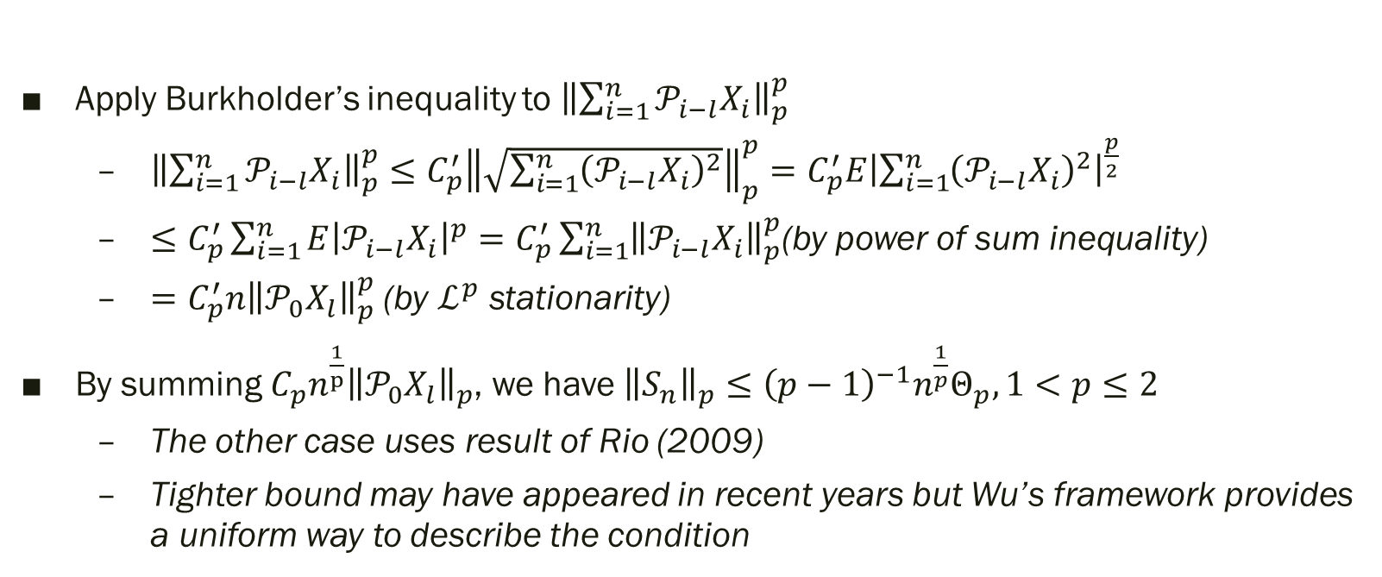
Proof of moment inequality
Apply Burkholder’s inequality to ${\left\|\sum_{i=1}^{n}{𝒫_{i−l}X_{i}}\right\|}_{p}^{p}$
${\left\|\sum_{i=1}^{n}{𝒫_{i−l}X_{i}}\right\|}_{p}^{p}≤C_{p}^{′}{\left\|\sqrt{\sum_{i=1}^{n}{{\left(𝒫_{i−l}X_{i}\right)}^{2}}}\right\|}_{p}^{p}=C_{p}^{′}E{\left|\sum_{i=1}^{n}{{\left(𝒫_{i−l}X_{i}\right)}^{2}}\right|}^{\frac{p}{2}}$
$≤C_{p}^{′}\sum_{i=1}^{n}{E{\left|𝒫_{i−l}X_{i}\right|}^{p}}=C_{p}^{′}\sum_{i=1}^{n}{{\left\|𝒫_{i−l}X_{i}\right\|}_{p}^{p}}$(by power of sum inequality)
$=C_{p}^{′}n{\left\|𝒫_{0}X_{l}\right\|}_{p}^{p}$ (by $ℒ^{p}$ stationarity)
By summing $C_{p}n^{\frac{1}{p}}{\left\|𝒫_{0}X_{l}\right\|}_{p}$, we have ${\left\|S_{n}\right\|}_{p}≤{\left(p−1\right)}^{−1}n^{\frac{1}{p}}Θ_{p}, 1<p≤2$
The other case uses result of Rio (2009)
Tighter bound may have appeared in recent years but Wu’s framework provides a uniform way to describe the condition

Slide 23
Proof of invariance principle
Doob's martingale inequality: to be discussed in the next paper

Slide 24
Gaussian Approximation
Section 6

Slide 25
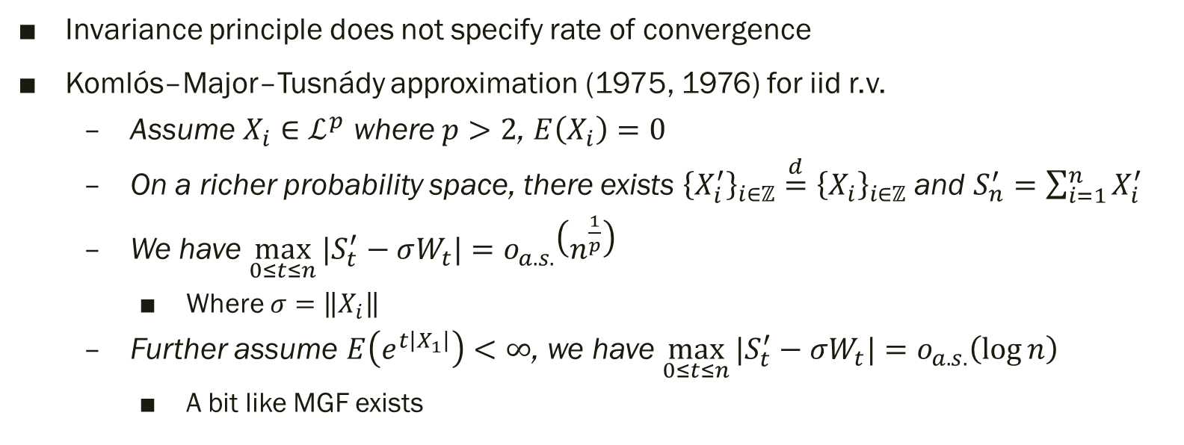
Strong invariance principle (p.8-9)
Invariance principle does not specify rate of convergence
Komlós–Major–Tusnády approximation (1975, 1976) for iid r.v.
Assume $X_{i}∈ℒ^{p}$ where $p>2$, $E\left(X_{i}\right)=0$
On a richer probability space, there exists ${\left\{X_{i}^{′}\right\}}_{i∈ℤ}\overset{d}{=}{\left\{X_{i}\right\}}_{i∈ℤ}$ and $S_{n}^{′}=\sum_{i=1}^{n}{X_{i}^{′}}$
We have $\max_{0≤t≤n}{|S_{t}^{′}−σW_{t}|}=o_{a.s.}\left(n^{\frac{1}{p}}\right)$
Where $σ=\left\|X_{i}\right\|$
Further assume $E\left(e^{t\left|X_{1}\right|}\right)<∞$, we have $\max_{0≤t≤n}{|S_{t}^{′}−σW_{t}|}=o_{a.s.}\left(\log{n}\right)$
A bit like MGF exists

Slide 26
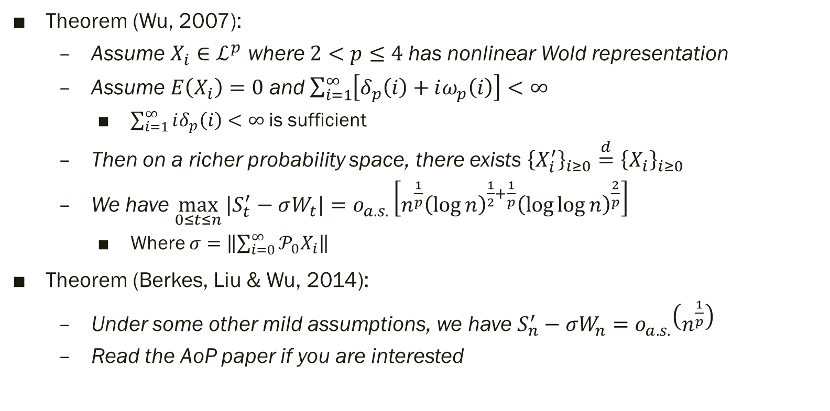
KMT approximation under dependence
Theorem (Wu, 2007):
Assume $X_{i}∈ℒ^{p}$ where $2<p≤4$has nonlinear Wold representation
Assume $E\left(X_{i}\right)=0$ and $\sum_{i=1}^{∞}{\left[δ_{p}\left(i\right)+iω_{p}\left(i\right)\right]}<∞$
$\sum_{i=1}^{∞}{iδ_{p}\left(i\right)}<∞$ is sufficient
Then on a richer probability space, there exists ${\left\{X_{i}^{′}\right\}}_{i≥0}\overset{d}{=}{\left\{X_{i}\right\}}_{i≥0}$
We have $\max_{0≤t≤n}{|S_{t}^{′}−σW_{t}|}=o_{a.s.}\left[n^{\frac{1}{p}}{\left(\log{n}\right)}^{\frac{1}{2}+\frac{1}{p}}{\left(\log{\log{n}}\right)}^{\frac{2}{p}}\right]$
Where $σ=\left\|\sum_{i=0}^{∞}{𝒫_{0}X_{i}}\right\|$
Theorem (Berkes, Liu & Wu, 2014):
Under some other mild assumptions, we have $S_{n}^{′}−σW_{n}=o_{a.s.}\left(n^{\frac{1}{p}}\right)$
Read the AoP paper if you are interested

Slide 27
Sample Covariance Function
Section 7

Slide 28
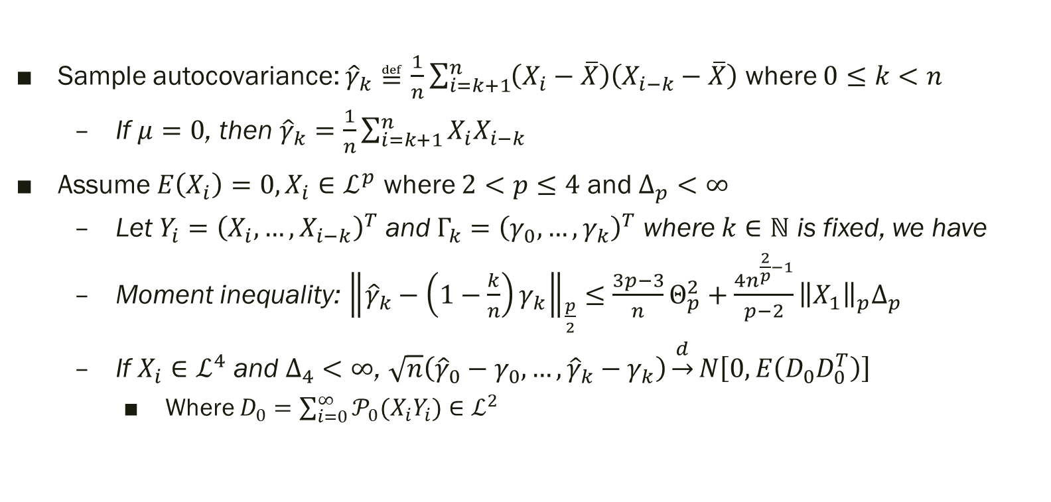

CLT with bounded $k$
Sample autocovariance: ${\hat{γ}}_{k}≝\frac{1}{n}\sum_{i=k+1}^{n}{\left(X_{i}−\overline{X}\right)\left(X_{i−k}−\overline{X}\right)}$ where $0≤k<n$
If $μ=0$, then ${\hat{γ}}_{k}=\frac{1}{n}\sum_{i=k+1}^{n}{X_{i}X_{i−k}}$
Assume $E\left(X_{i}\right)=0, X_{i}∈ℒ^{p}$ where $2<p≤4$ and $Δ_{p}<∞$
Let $Y_{i}={\left(X_{i},…,X_{i−k}\right)}^{T}$ and $Γ_{k}={\left(γ_{0},…,γ_{k}\right)}^{T}$ where $k∈ℕ$ is fixed, we have
Moment inequality: ${\left\|{\hat{γ}}_{k}−\left(1−\frac{k}{n}\right)γ_{k}\right\|}_{\frac{p}{2}}≤\frac{3p−3}{n}Θ_{p}^{2}+\frac{4n^{\frac{2}{p}−1}}{p−2}{\left\|X_{1}\right\|}_{p}Δ_{p}$
If $X_{i}∈ℒ^{4}$ and $Δ_{4}<∞$, $\sqrt{n}\left({\hat{γ}}_{0}−γ_{0},…,{\hat{γ}}_{k}−γ_{k}\right)\underset{→}{d}N\left[0,E\left(D_{0}D_{0}^{T}\right)\right]$
Where $D_{0}=\sum_{i=0}^{∞}{𝒫_{0}(X_{i}Y_{i})}∈ℒ^{2}$

Slide 29
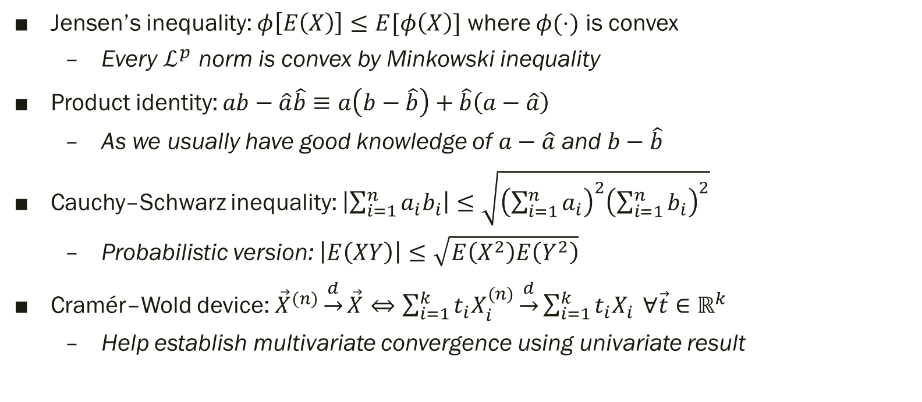

Proof of bounded $k$ (p.10)
Jensen’s inequality: $φ\left[E\left(X\right)\right]≤E[φ\left(X\right)]$ where $φ(⋅)$ is convex
Every $ℒ^{p}$ norm is convex by Minkowski inequality
Product identity: $ab−\hat{a}\hat{b}≡a\left(b−\hat{b}\right)+\hat{b}\left(a−\hat{a}\right)$
As we usually have good knowledge of $a−\hat{a}$ and $b−\hat{b}$
Cauchy–Schwarz inequality: $\left|\sum_{i=1}^{n}{a_{i}b_{i}}\right|≤\sqrt{{\left(\sum_{i=1}^{n}{a_{i}}\right)}^{2}{\left(\sum_{i=1}^{n}{b_{i}}\right)}^{2}}$
Probabilistic version: $\left|E\left(XY\right)\right|≤\sqrt{E\left(X^{2}\right)E\left(Y^{2}\right)}$
Cramér–Wold device: ${\vec{X}}^{(n)}\underset{→}{d}\vec{X}⇔\sum_{i=1}^{k}{t_{i}X_{i}^{(n)}}\underset{→}{d}\sum_{i=1}^{k}{t_{i}X_{i}} ∀\vec{t}∈ℝ^{k}$
Help establish multivariate convergence using univariate result

Slide 30
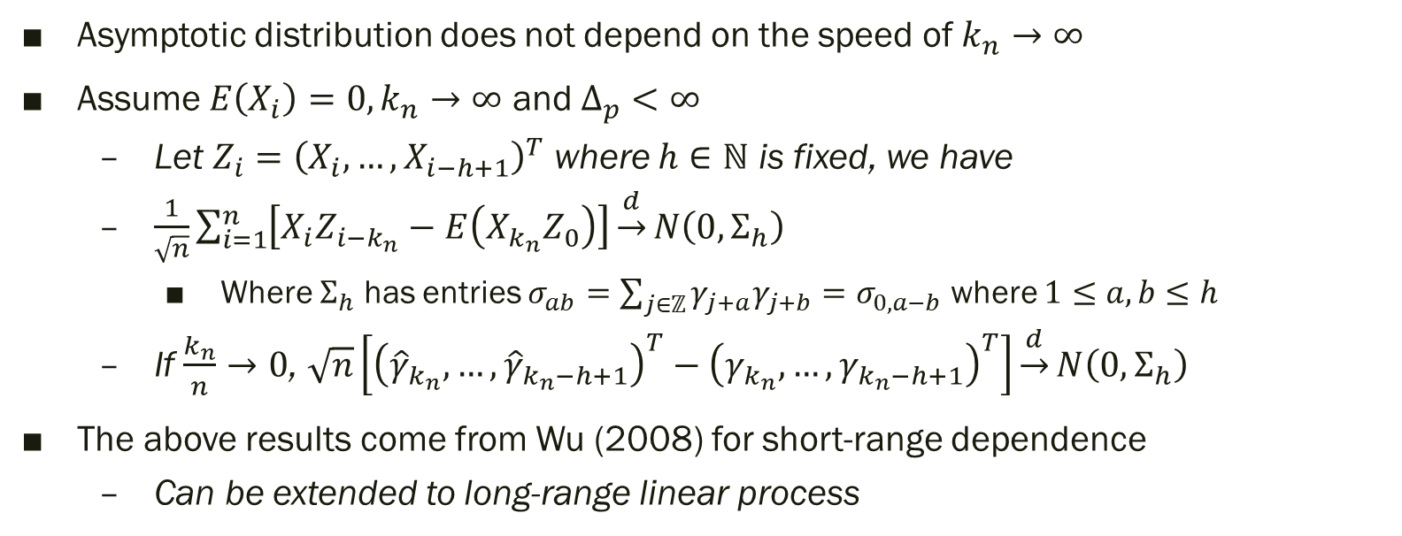

CLT with unbounded $k$
Asymptotic distribution does not depend on the speed of $k_{n}→∞$
Assume $E\left(X_{i}\right)=0, k_{n}→∞$ and $Δ_{p}<∞$
Let $Z_{i}={\left(X_{i},…,X_{i−h+1}\right)}^{T}$ where $h∈ℕ$ is fixed, we have
$\frac{1}{\sqrt{n}}\sum_{i=1}^{n}{\left[X_{i}Z_{i−k_{n}}−E\left(X_{k_{n}}Z_{0}\right)\right]}\underset{→}{d}N\left(0,Σ_{h}\right)$
Where $Σ_{h}$ has entries $σ_{ab}=\sum_{j∈ℤ}{γ_{j+a}γ_{j+b}}=σ_{0,a−b}$ where $1≤a,b≤h$
If $\frac{k_{n}}{n}→0$, $\sqrt{n}\left[{\left({\hat{γ}}_{k_{n}},…,{\hat{γ}}_{k_{n}−h+1}\right)}^{T}−{\left(γ_{k_{n}},…,γ_{k_{n}−h+1}\right)}^{T}\right]\underset{→}{d}N\left(0,Σ_{h}\right)$
The above results come from Wu (2008) for short-range dependence
Can be extended to long-range linear process

Slide 31
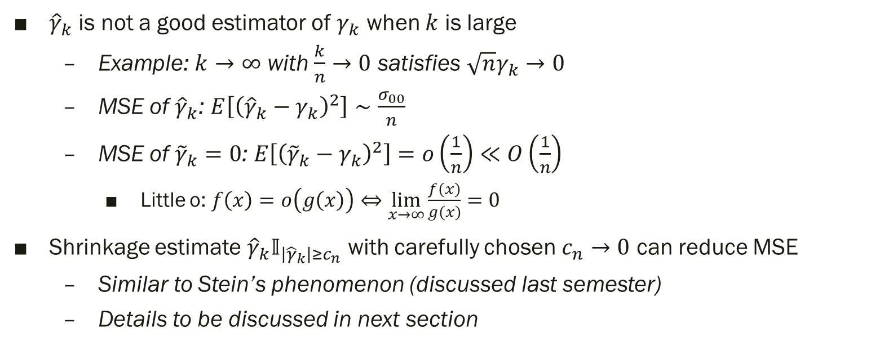
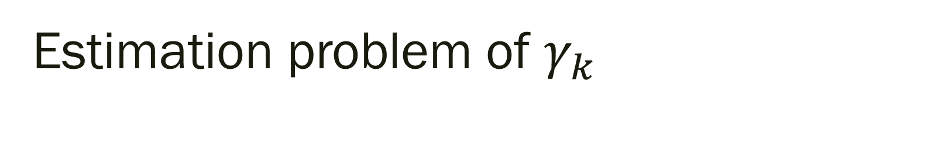
Estimation problem of $γ_{k}$
${\hat{γ}}_{k}$ is not a good estimator of $γ_{k}$ when $k$ is large
Example: $k→∞$ with $\frac{k}{n}→0$ satisfies $\sqrt{n}γ_{k}→0$
MSE of ${\hat{γ}}_{k}$: $E\left[{\left({\hat{γ}}_{k}−γ_{k}\right)}^{2}\right]∼\frac{σ_{00}}{n}$
MSE of ${\tilde{γ}}_{k}=0$: $E\left[{\left({\tilde{γ}}_{k}−γ_{k}\right)}^{2}\right]=o\left(\frac{1}{n}\right)≪O\left(\frac{1}{n}\right)$
Little o: $f\left(x\right)=o\left(g\left(x\right)\right)⇔\lim_{x→∞}{\frac{f\left(x\right)}{g\left(x\right)}}=0$
Shrinkage estimate ${\hat{γ}}_{k}𝕀_{\left|{\hat{γ}}_{k}\right|≥c_{n}}$ with carefully chosen $c_{n}→0$ can reduce MSE
Similar to Stein’s phenomenon (discussed last semester)
Details to be discussed in next section

Slide 32
Estimation of Covariance Matrix
Section 8

Slide 33
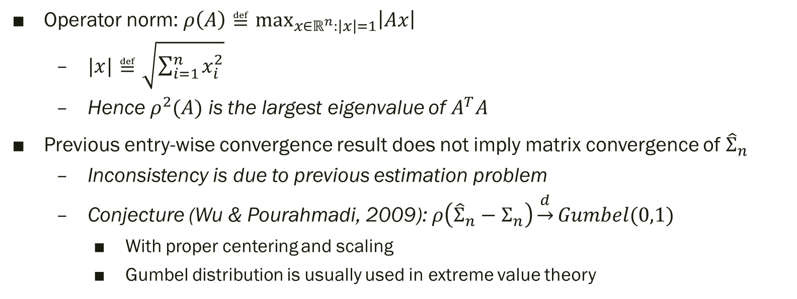

Convergence problem of ${\hat{Σ}}_{n}$ (p.11)
Operator norm: $ρ\left(A\right)≝\max_{x∈ℝ^{n}:\left|x\right|=1}\left|Ax\right|$
$|x|≝\sqrt{\sum_{i=1}^{n}{x_{i}^{2}}}$
Hence $ρ^{2}(A)$ is the largest eigenvalue of $A^{T}A$
Previous entry-wise convergence result does not imply matrix convergence of ${\hat{Σ}}_{n}$
Inconsistency is due to previous estimation problem
Conjecture (Wu & Pourahmadi, 2009): $ρ\left({\hat{Σ}}_{n}−Σ_{n}\right)\underset{→}{d}Gumbel(0,1)$
With proper centering and scaling
Gumbel distribution is usually used in extreme value theory

Slide 34
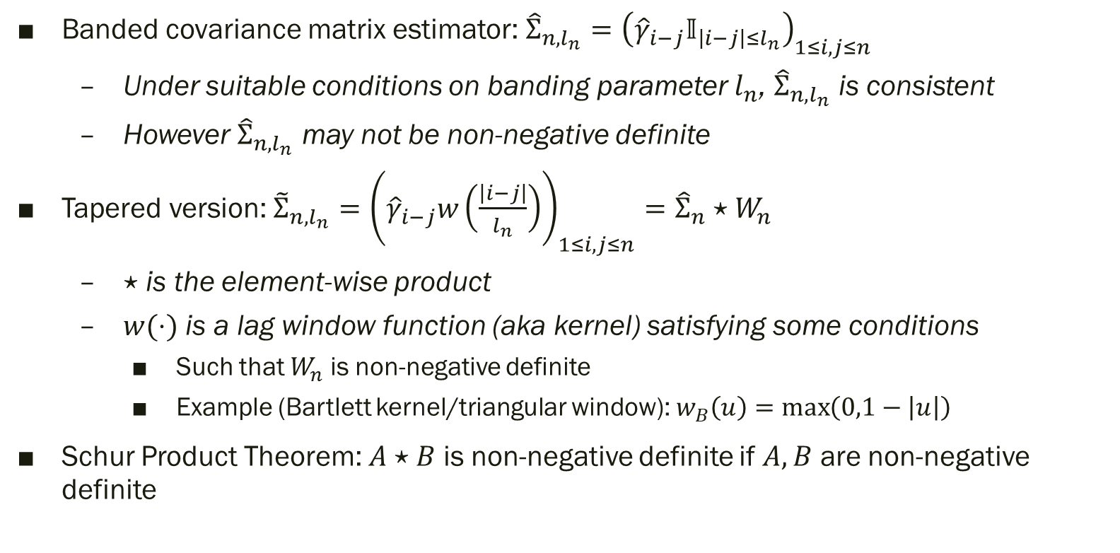
Truncation technique
Banded covariance matrix estimator: ${\hat{Σ}}_{n,l_{n}}={\left({\hat{γ}}_{i−j}𝕀_{\left|i−j\right|≤l_{n}}\right)}_{1≤i,j≤n}$
Under suitable conditions on banding parameter $l_{n}$, ${\hat{Σ}}_{n,l_{n}}$ is consistent
However ${\hat{Σ}}_{n,l_{n}}$ may not be non-negative definite
Tapered version: ${\tilde{Σ}}_{n,l_{n}}={\left({\hat{γ}}_{i−j}w\left(\frac{\left|i−j\right|}{l_{n}}\right)\right)}_{1≤i,j≤n}={\hat{Σ}}_{n}⋆W_{n}$
$⋆$ is the element-wise product
$w(⋅)$ is a lag window function (aka kernel) satisfying some conditions
Such that $W_{n}$ is non-negative definite
Example (Bartlett kernel/triangular window): $w_{B}\left(u\right)=\max\left(0,1−\left|u\right|\right)$
Schur Product Theorem: $A⋆B$ is non-negative definite if $A,B$ are non-negative definite

Slide 35
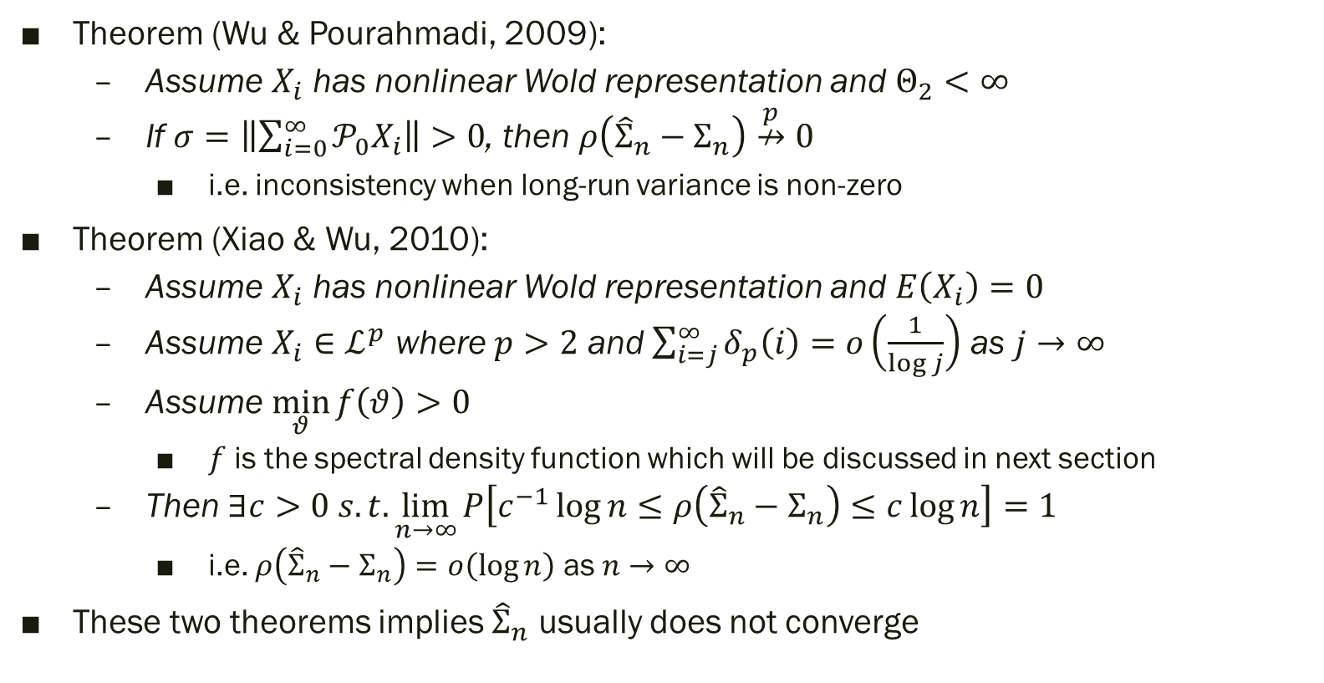

Result of ${\hat{Σ}}_{n}$
Theorem (Wu & Pourahmadi, 2009):
Assume $X_{i}$ has nonlinear Wold representation and $Θ_{2}<∞$
If $σ=\left\|\sum_{i=0}^{∞}{𝒫_{0}X_{i}}\right\|>0$, then $ρ\left({\hat{Σ}}_{n}−Σ_{n}\right)\overset{p}{↛}0$
i.e. inconsistency when long-run variance is non-zero
Theorem (Xiao & Wu, 2010):
Assume $X_{i}$ has nonlinear Wold representation and $E\left(X_{i}\right)=0$
Assume $X_{i}∈ℒ^{p}$ where $p>2$ and $\sum_{i=j}^{∞}{δ_{p}\left(i\right)}=o\left(\frac{1}{\log{j}}\right)$ as $j→∞$
Assume $\min_{θ}{f\left(θ\right)}>0$
$f$ is the spectral density function which will be discussed in next section
Then $∃c>0 s.t. \lim_{n→∞}{P\left[c^{−1}\log{n}≤ρ\left({\hat{Σ}}_{n}−Σ_{n}\right)≤c\log{n}\right]}=1$
i.e. $ρ\left({\hat{Σ}}_{n}−Σ_{n}\right)=o\left(\log{n}\right)$ as $n→∞$
These two theorems implies ${\hat{Σ}}_{n}$ usually does not converge

Slide 36
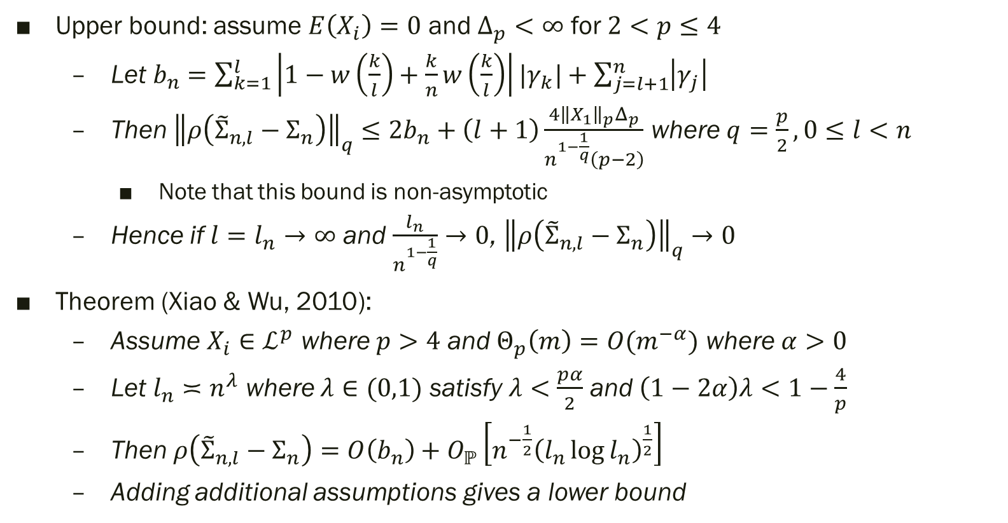

Result of ${\tilde{Σ}}_{n,l_{n}}$
Upper bound: assume $E\left(X_{i}\right)=0$ and $Δ_{p}<∞$ for $2<p≤4$
Let $b_{n}=\sum_{k=1}^{l}{\left|1−w\left(\frac{k}{l}\right)+\frac{k}{n}w\left(\frac{k}{l}\right)\right||γ_{k}|}+\sum_{j=l+1}^{n}{\left|γ_{j}\right|}$
Then ${\left\|ρ\left({\tilde{Σ}}_{n,l}−Σ_{n}\right)\right\|}_{q}≤2b_{n}+\left(l+1\right)\frac{4{\left\|X_{1}\right\|}_{p}Δ_{p}}{n^{1−\frac{1}{q}}\left(p−2\right)}$ where $q=\frac{p}{2}, 0≤l<n$
Note that this bound is non-asymptotic
Hence if $l=l_{n}→∞$ and $\frac{l_{n}}{n^{1−\frac{1}{q}}}→0$, ${\left\|ρ\left({\tilde{Σ}}_{n,l}−Σ_{n}\right)\right\|}_{q}→0$
Theorem (Xiao & Wu, 2010):
Assume $X_{i}∈ℒ^{p}$ where $p>4$ and $Θ_{p}\left(m\right)=O(m^{−α})$ where $α>0$
Let $l_{n}≍n^{λ}$ where $λ∈(0,1)$ satisfy $λ<\frac{pα}{2}$ and $\left(1−2α\right)λ<1−\frac{4}{p}$
Then $ρ\left({\tilde{Σ}}_{n,l}−Σ_{n}\right)=O\left(b_{n}\right)+O_{ℙ}\left[n^{−\frac{1}{2}}{\left(l_{n}\log{l_{n}}\right)}^{\frac{1}{2}}\right]$
Adding additional assumptions gives a lower bound

Slide 37
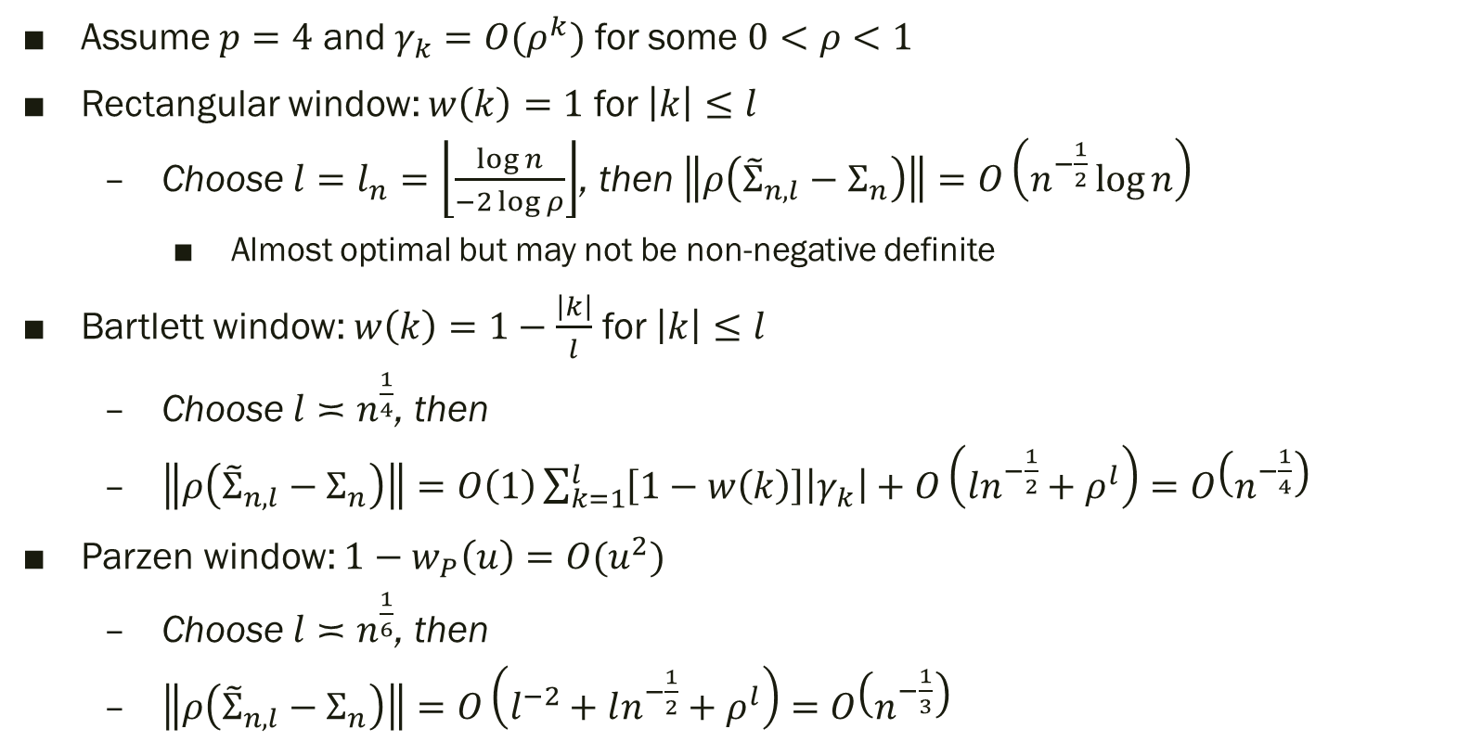
Special cases (p.12)
Assume $p=4$ and $γ_{k}=O(ρ^{k})$ for some $0<ρ<1$
Rectangular window: $w\left(k\right)=1$ for $\left|k\right|≤l$
Choose $l=l_{n}=\left\lfloor \frac{\log{n}}{−2\log{ρ}}\right\rfloor$, then $\left\|ρ\left({\tilde{Σ}}_{n,l}−Σ_{n}\right)\right\|=O\left(n^{−\frac{1}{2}}\log{n}\right)$
Almost optimal but may not be non-negative definite
Bartlett window: $w\left(k\right)=1−\frac{\left|k\right|}{l}$ for $\left|k\right|≤l$
Choose $l≍n^{\frac{1}{4}}$, then
$\left\|ρ\left({\tilde{Σ}}_{n,l}−Σ_{n}\right)\right\|=O\left(1\right)\sum_{k=1}^{l}{\left[1−w\left(k\right)\right]\left|γ_{k}\right|}+O\left(ln^{−\frac{1}{2}}+ρ^{l}\right)=O\left(n^{−\frac{1}{4}}\right)$
Parzen window: $1−w_{P}\left(u\right)=O(u^{2})$
Choose $l≍n^{\frac{1}{6}}$, then
$\left\|ρ\left({\tilde{Σ}}_{n,l}−Σ_{n}\right)\right\|=O\left(l^{−2}+ln^{−\frac{1}{2}}+ρ^{l}\right)=O\left(n^{−\frac{1}{3}}\right)$

Slide 38
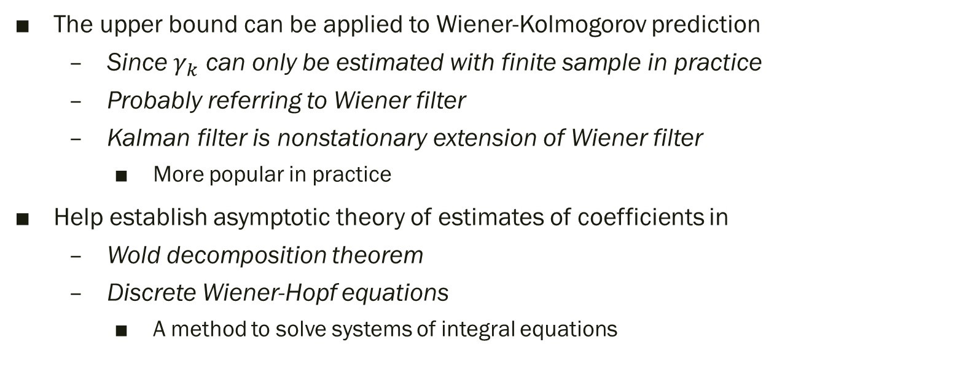
Application
The upper bound can be applied to Wiener-Kolmogorov prediction
Since $γ_{k}$ can only be estimated with finite sample in practice
Probably referring to Wiener filter
Kalman filter is nonstationary extension of Wiener filter
More popular in practice
Help establish asymptotic theory of estimates of coefficients in
Wold decomposition theorem
Discrete Wiener-Hopf equations
A method to solve systems of integral equations

Slide 39
Periodograms
Section 9

Slide 40
Frequency domain
Time domain: changes of a signal with respect to time
Frequency domain: changes of a signal with respect to frequency
How much of a signal lies within each given band over a range of frequencies
Why frequency domain?
Simplify the mathematical analysis
Give an intuitive understanding of the qualitative behavior of the system
E.g. periodicity, power

Slide 41
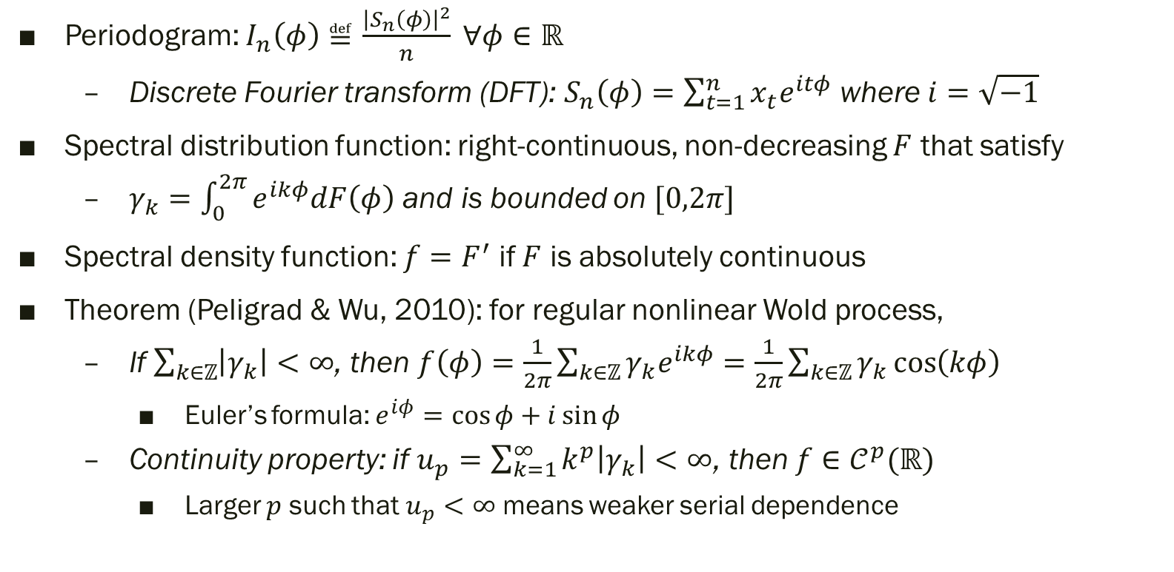
Tools (p.12-13)
Periodogram: $I_{n}\left(φ\right)≝\frac{{\left|S_{n}\left(φ\right)\right|}^{2}}{n} ∀φ∈ℝ$
Discrete Fourier transform (DFT): $S_{n}\left(φ\right)=\sum_{t=1}^{n}{x_{t}e^{itφ}}$ where $i=\sqrt{−1}$
Spectral distribution function: right-continuous, non-decreasing $F$ that satisfy
$γ_{k}=\int_{0}^{2π}{e^{ikφ}dF\left(φ\right)}$ and is bounded on $[0,2π]$
Spectral density function: $f=F^{′}$ if $F$ is absolutely continuous
Theorem (Peligrad & Wu, 2010): for regular nonlinear Wold process,
If $\sum_{k∈ℤ}{\left|γ_{k}\right|}<∞$, then $f\left(φ\right)=\frac{1}{2π}\sum_{k∈ℤ}{γ_{k}e^{ikφ}}=\frac{1}{2π}\sum_{k∈ℤ}{γ_{k}\cos\left(kφ\right)}$
Euler’s formula: $e^{iφ}=\cos{φ}+i\sin{φ}$
Continuity property: if $u_{p}=\sum_{k=1}^{∞}{k^{p}\left|γ_{k}\right|}<∞$, then $f∈𝒞^{p}(ℝ)$
Larger $p$ such that $u_{p}<∞$ means weaker serial dependence

Slide 42
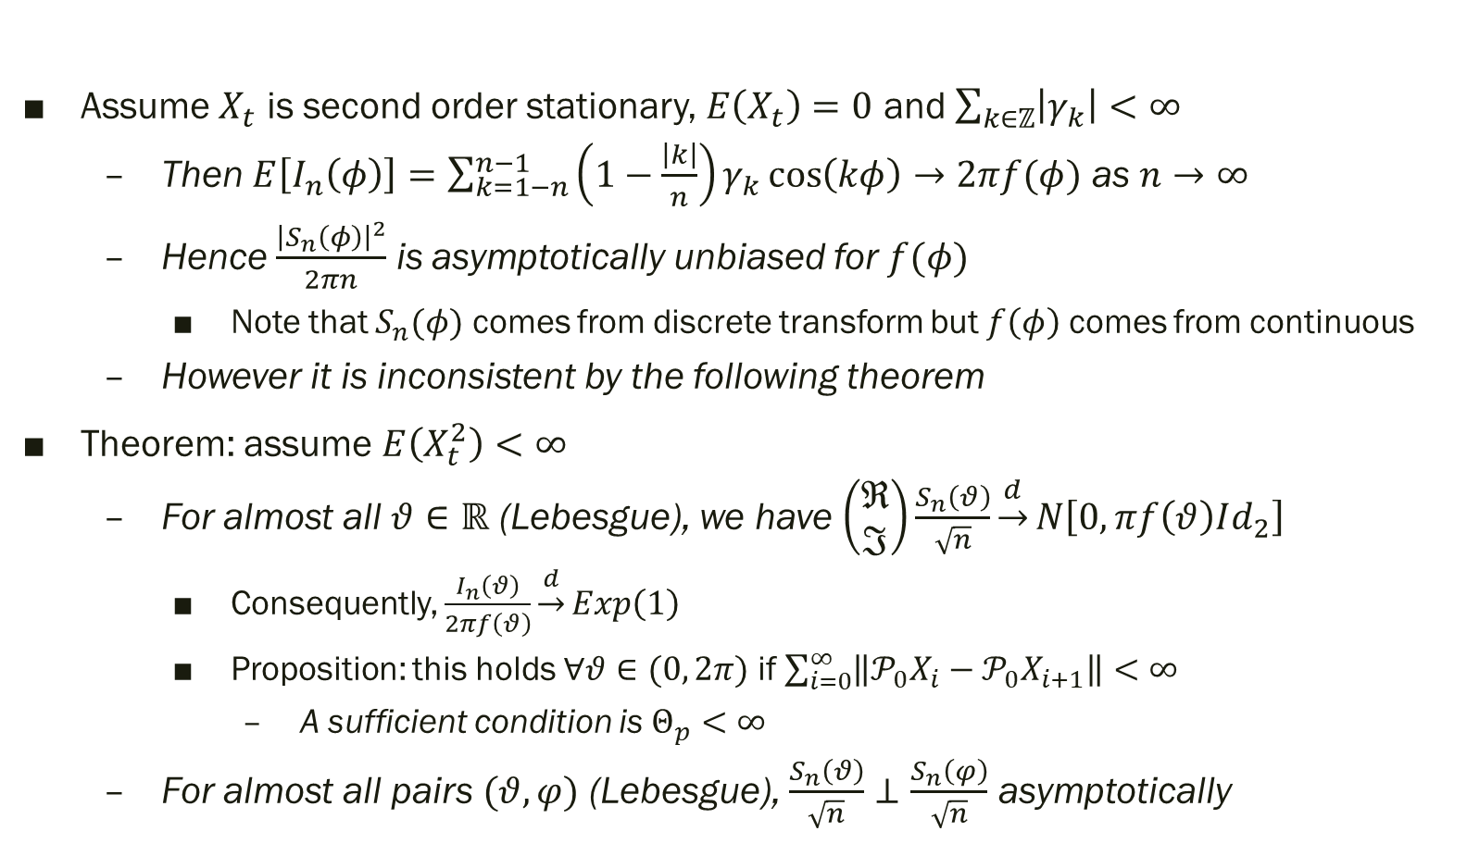

Central limit problem of $S_{n}\left(φ\right)$
Assume $X_{t}$ is second order stationary, $E\left(X_{t}\right)=0$ and $\sum_{k∈ℤ}{\left|γ_{k}\right|}<∞$
Then $E\left[I_{n}\left(φ\right)\right]=\sum_{k=1−n}^{n−1}{\left(1−\frac{\left|k\right|}{n}\right)γ_{k}\cos\left(kφ\right)}→2πf(φ)$ as $n→∞$
Hence $\frac{{\left|S_{n}\left(φ\right)\right|}^{2}}{2πn}$ is asymptotically unbiased for $f(φ)$
Note that $S_{n}(φ)$ comes from discrete transform but $f\left(φ\right)$ comes from continuous
However it is inconsistent by the following theorem
Theorem: assume $E\left(X_{t}^{2}\right)<∞$
For almost all $θ∈ℝ$ (Lebesgue), we have $\left(\begin{matrix}ℜ \\ ℑ\end{matrix}\right)\frac{S_{n}\left(θ\right)}{\sqrt{n}}\underset{→}{d}N\left[0, πf\left(θ\right)Id_{2}\right]$
Consequently, $\frac{I_{n}\left(θ\right)}{2πf\left(θ\right)}\underset{→}{d}Exp\left(1\right)$
Proposition: this holds $∀θ∈(0, 2π)$ if $\sum_{i=0}^{∞}{\left\|𝒫_{0}X_{i}−𝒫_{0}X_{i+1}\right\|}<∞$
A sufficient condition is $Θ_{p}<∞$
For almost all pairs $(θ, φ)$ (Lebesgue), $\frac{S_{n}\left(θ\right)}{\sqrt{n}}⊥\frac{S_{n}\left(φ\right)}{\sqrt{n}}$ asymptotically

Slide 43
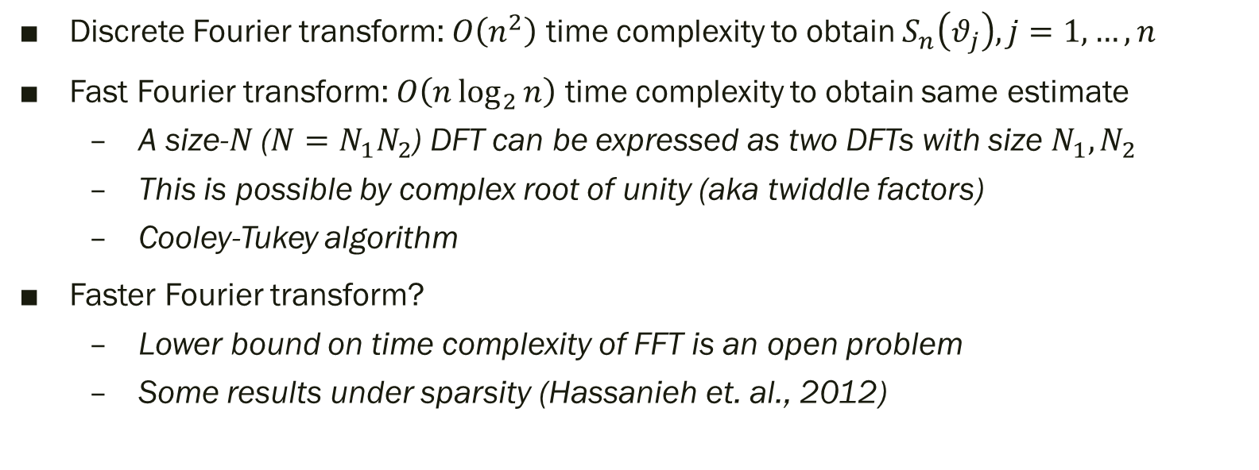
Fast Fourier transform
Discrete Fourier transform: $O\left(n^{2}\right)$ time complexity to obtain $S_{n}\left(θ_{j}\right), j=1,…,n$
Fast Fourier transform: $O\left(n\log_{2}{n}\right)$ time complexity to obtain same estimate
A size-$N$ ($N=N_{1}N_{2}$) DFT can be expressed as two DFTs with size $N_{1},N_{2}$
This is possible by complex root of unity (aka twiddle factors)
Cooley-Tukey algorithm
Faster Fourier transform?
Lower bound on time complexity of FFT is an open problem
Some results under sparsity (Hassanieh et. al., 2012)

Slide 44
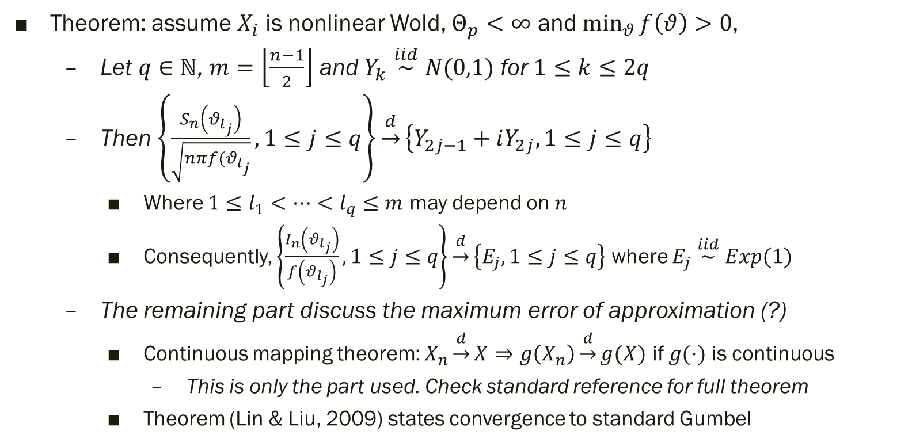

Central limit problem of $S_{n}\left(θ_{j}\right)$
Theorem: assume $X_{i}$ is nonlinear Wold, $Θ_{p}<∞$ and $\min_{θ}{f\left(θ\right)}>0$,
Let $q∈ℕ$, $m=\left\lfloor \frac{n−1}{2}\right\rfloor$ and $Y_{k}\overset{iid}{∼}N(0,1)$ for $1≤k≤2q$
Then $\left\{\frac{S_{n}\left(θ_{l_{j}}\right)}{\sqrt{nπf(θ_{l_{j}}}}, 1≤j≤q\right\}\underset{→}{d}\left\{Y_{2j−1}+iY_{2j}, 1≤j≤q\right\}$
Where $1≤l_{1}<…<l_{q}≤m$ may depend on $n$
Consequently, $\left\{\frac{I_{n}\left(θ_{l_{j}}\right)}{f\left(θ_{l_{j}}\right)}, 1≤j≤q\right\}\underset{→}{d}\left\{E_{j}, 1≤j≤q\right\}$ where $E_{j}\overset{iid}{∼}Exp(1)$
The remaining part discuss the maximum error of approximation (?)
Continuous mapping theorem: $X_{n}\underset{→}{d}X⇒g\left(X_{n}\right)\underset{→}{d}g(X)$ if $g(⋅)$ is continuous
This is only the part used. Check standard reference for full theorem
Theorem (Lin & Liu, 2009) states convergence to standard Gumbel

Slide 45
Estimation of Spectral Densities
Section 10

Slide 46
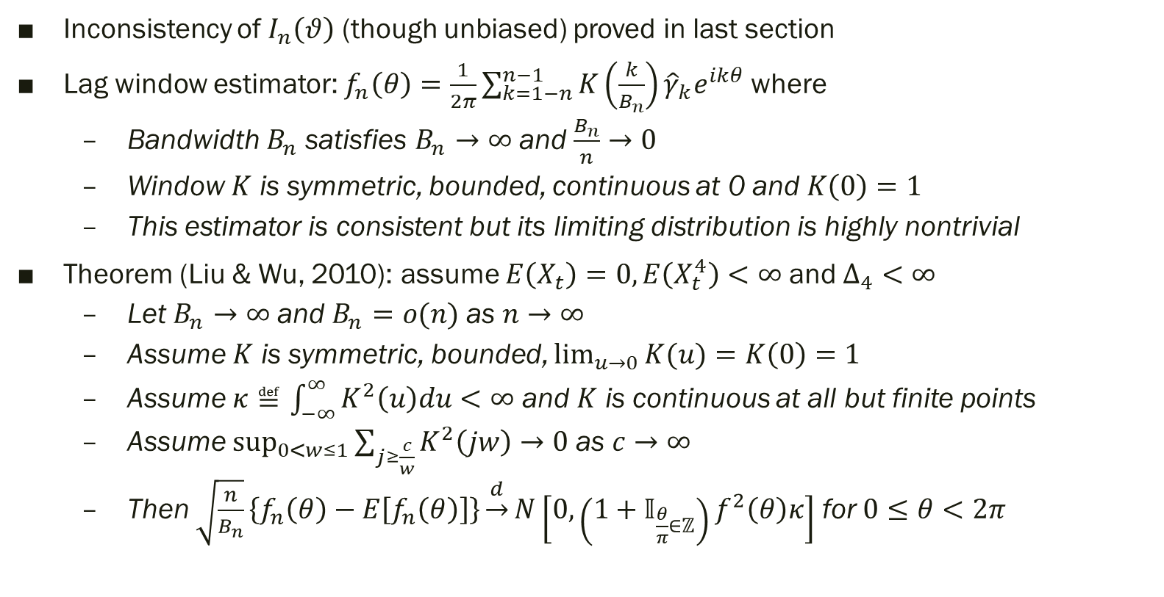
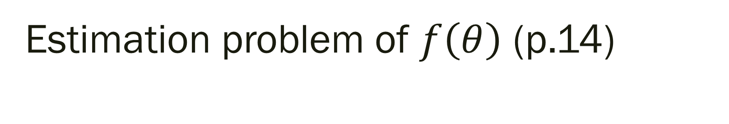
Estimation problem of $f\left(θ\right)$ (p.14)
Inconsistency of $I_{n}\left(θ\right)$ (though unbiased) proved in last section
Lag window estimator: $f_{n}\left(θ\right)=\frac{1}{2π}\sum_{k=1−n}^{n−1}{K\left(\frac{k}{B_{n}}\right){\hat{γ}}_{k}e^{ikθ}}$ where
Bandwidth $B_{n}$ satisfies $B_{n}→∞$ and $\frac{B_{n}}{n}→0$
Window $K$ is symmetric, bounded, continuous at 0 and $K\left(0\right)=1$
This estimator is consistent but its limiting distribution is highly nontrivial
Theorem (Liu & Wu, 2010): assume $E\left(X_{t}\right)=0, E\left(X_{t}^{4}\right)<∞$ and $Δ_{4}<∞$
Let $B_{n}→∞$ and $B_{n}=o(n)$ as $n→∞$
Assume $K$ is symmetric, bounded, $\lim_{u→0}{K(u)}=K\left(0\right)=1$
Assume $κ≝\int_{−∞}^{∞}{K^{2}\left(u\right)du}<∞$ and $K$ is continuous at all but finite points
Assume $\sup_{0<w≤1}{\sum_{j≥\frac{c}{w}}{K^{2}\left(jw\right)}}→0$ as $c→∞$
Then $\sqrt{\frac{n}{B_{n}}}\left\{f_{n}\left(θ\right)−E\left[f_{n}\left(θ\right)\right]\right\}\underset{→}{d}N\left[0, \left(1+𝕀_{\frac{θ}{π}∈ℤ}\right)f^{2}\left(θ\right)κ\right]$ for $0≤θ<2π$

Slide 47
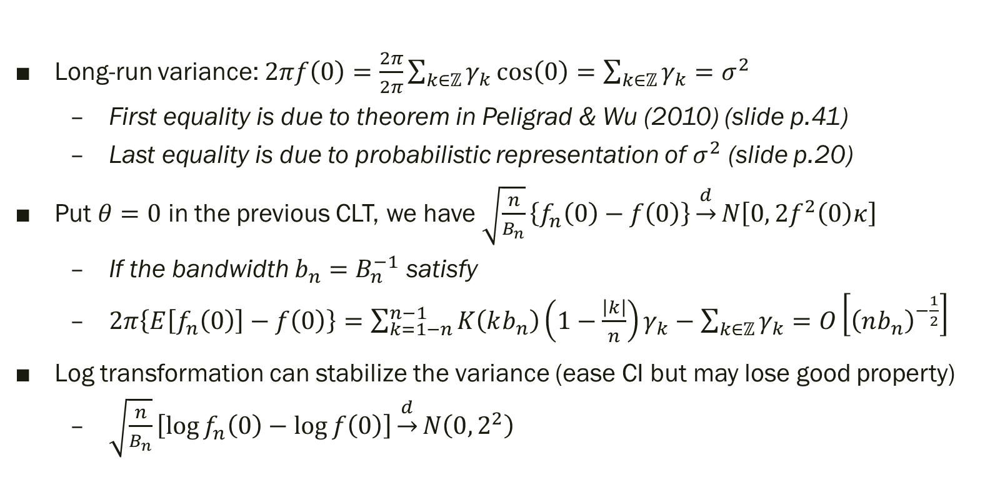
Long-run variance
Long-run variance: $2πf\left(0\right)=\frac{2π}{2π}\sum_{k∈ℤ}{γ_{k}\cos\left(0\right)}=\sum_{k∈ℤ}{γ_{k}}=σ^{2}$
First equality is due to theorem in Peligrad & Wu (2010) (slide p.41)
Last equality is due to probabilistic representation of $σ^{2}$ (slide p.20)
Put $θ=0$ in the previous CLT, we have$\sqrt{\frac{n}{B_{n}}}\left\{f_{n}\left(0\right)−f\left(0\right)\right\}\underset{→}{d}N\left[0, 2f^{2}\left(0\right)κ\right]$
If the bandwidth $b_{n}=B_{n}^{−1}$ satisfy
$2π\left\{E\left[f_{n}\left(0\right)\right]−f\left(0\right)\right\}=\sum_{k=1−n}^{n−1}{K\left(kb_{n}\right)\left(1−\frac{\left|k\right|}{n}\right)γ_{k}}−\sum_{k∈ℤ}{γ_{k}}=O\left[{\left(nb_{n}\right)}^{−\frac{1}{2}}\right]$
Log transformation can stabilize the variance (ease CI but may lose good property)
$\sqrt{\frac{n}{B_{n}}}\left[\log{f_{n}\left(0\right)}−\log{f\left(0\right)}\right]\underset{→}{d}N\left(0, 2^{2}\right)$

Slide 48
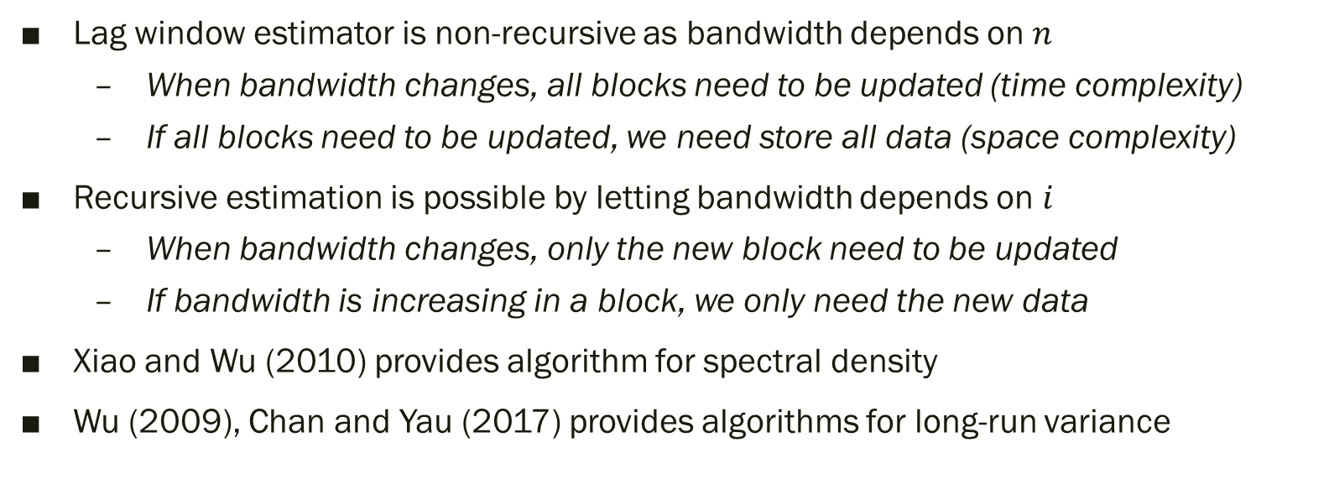
Recursive estimation
Lag window estimator is non-recursive as bandwidth depends on $n$
When bandwidth changes, all blocks need to be updated (time complexity)
If all blocks need to be updated, we need store all data (space complexity)
Recursive estimation is possible by letting bandwidth depends on $i$
When bandwidth changes, only the new block need to be updated
If bandwidth is increasing in a block, we only need the new data
Xiao and Wu (2010) provides algorithm for spectral density
Wu (2009), Chan and Yau (2017) provides algorithms for long-run variance

Slide 49
Kernel Estimation
Section 11

Slide 50
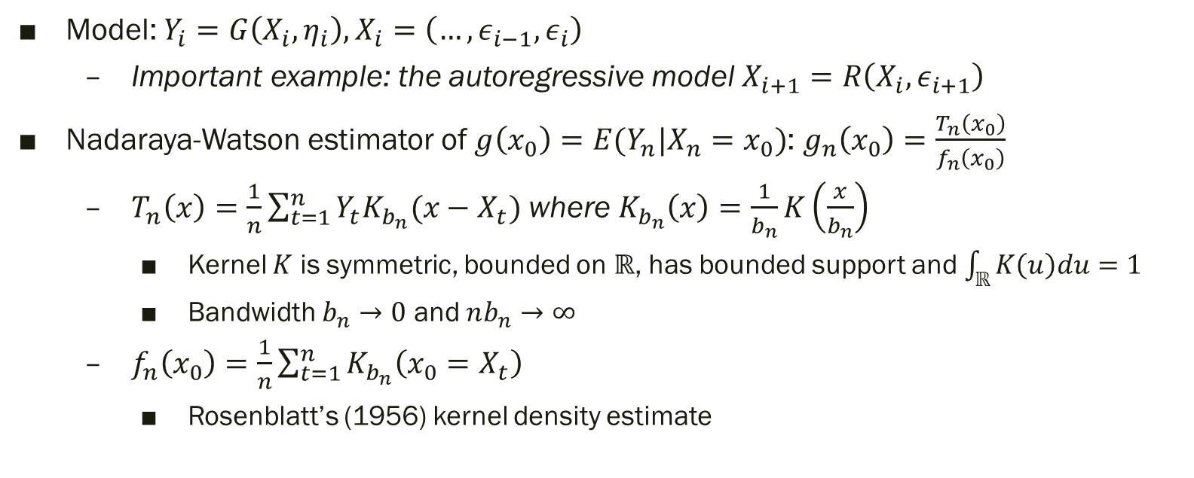
Kernel regression
Model: $Y_{i}=G\left(X_{i},η_{i}\right), X_{i}=\left(…,ε_{i−1},ε_{i}\right)$
Important example: the autoregressive model $X_{i+1}=R\left(X_{i},ε_{i+1}\right)$
Nadaraya-Watson estimator of $g\left(x_{0}\right)=E(Y_{n}|X_{n}=x_{0})$: $g_{n}\left(x_{0}\right)=\frac{T_{n}\left(x_{0}\right)}{f_{n}\left(x_{0}\right)}$
$T_{n}\left(x\right)=\frac{1}{n}\sum_{t=1}^{n}{Y_{t}K_{b_{n}}(x−X_{t})}$ where $K_{b_{n}}\left(x\right)=\frac{1}{b_{n}}K\left(\frac{x}{b_{n}}\right)$
Kernel $K$ is symmetric, bounded on $ℝ$, has bounded support and $\int_{ℝ}{K\left(u\right)du}=1$
Bandwidth $b_{n}→0$ and $nb_{n}→∞$
$f_{n}\left(x_{0}\right)=\frac{1}{n}\sum_{t=1}^{n}{K_{b_{n}}\left(x_{0}=X_{t}\right)}$
Rosenblatt’s (1956) kernel density estimate

Slide 51
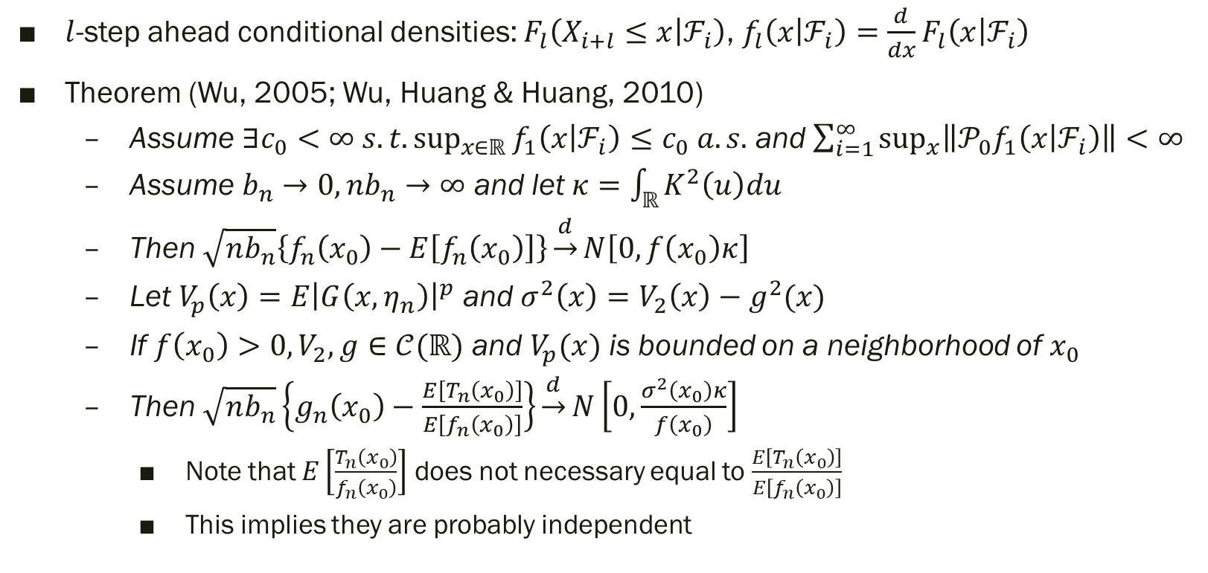

CLT for $g_{n}\left(x_{0}\right)$
$l$-step ahead conditional densities: $F_{l}\left(X_{i+l}≤x | ℱ_{i}\right)$, $f_{l}\left(x | ℱ_{i}\right)=\frac{d}{dx}F_{l}\left(x | ℱ_{i}\right)$
Theorem (Wu, 2005; Wu, Huang & Huang, 2010)
Assume $∃c_{0}<∞ s.t.\sup_{x∈ℝ}{f_{1}\left(x | ℱ_{i}\right)}≤c_{0} a.s.$ and $\sum_{i=1}^{∞}{\sup_{x}\left\|𝒫_{0}f_{1}\left(x | ℱ_{i}\right)\right\|}<∞$
Assume $b_{n}→0, nb_{n}→∞$ and let $κ=\int_{ℝ}{K^{2}\left(u\right)du}$
Then $\sqrt{nb_{n}}\left\{f_{n}\left(x_{0}\right)−E\left[f_{n}\left(x_{0}\right)\right]\right\}\underset{→}{d}N\left[0,f\left(x_{0}\right)κ\right]$
Let $V_{p}\left(x\right)=E{\left|G\left(x,η_{n}\right)\right|}^{p}$ and $σ^{2}\left(x\right)=V_{2}\left(x\right)−g^{2}(x)$
If $f\left(x_{0}\right)>0, V_{2},g∈𝒞(ℝ)$ and $V_{p}(x)$ is bounded on a neighborhood of $x_{0}$
Then $\sqrt{nb_{n}}\left\{g_{n}\left(x_{0}\right)−\frac{E\left[T_{n}\left(x_{0}\right)\right]}{E\left[f_{n}\left(x_{0}\right)\right]}\right\}\underset{→}{d}N\left[0,\frac{σ^{2}\left(x_{0}\right)κ}{f\left(x_{0}\right)}\right]$
Note that $E\left[\frac{T_{n}\left(x_{0}\right)}{f_{n}\left(x_{0}\right)}\right]$ does not necessary equal to $\frac{E\left[T_{n}\left(x_{0}\right)\right]}{E\left[f_{n}\left(x_{0}\right)\right]}$
This implies they are probably independent

Slide 52
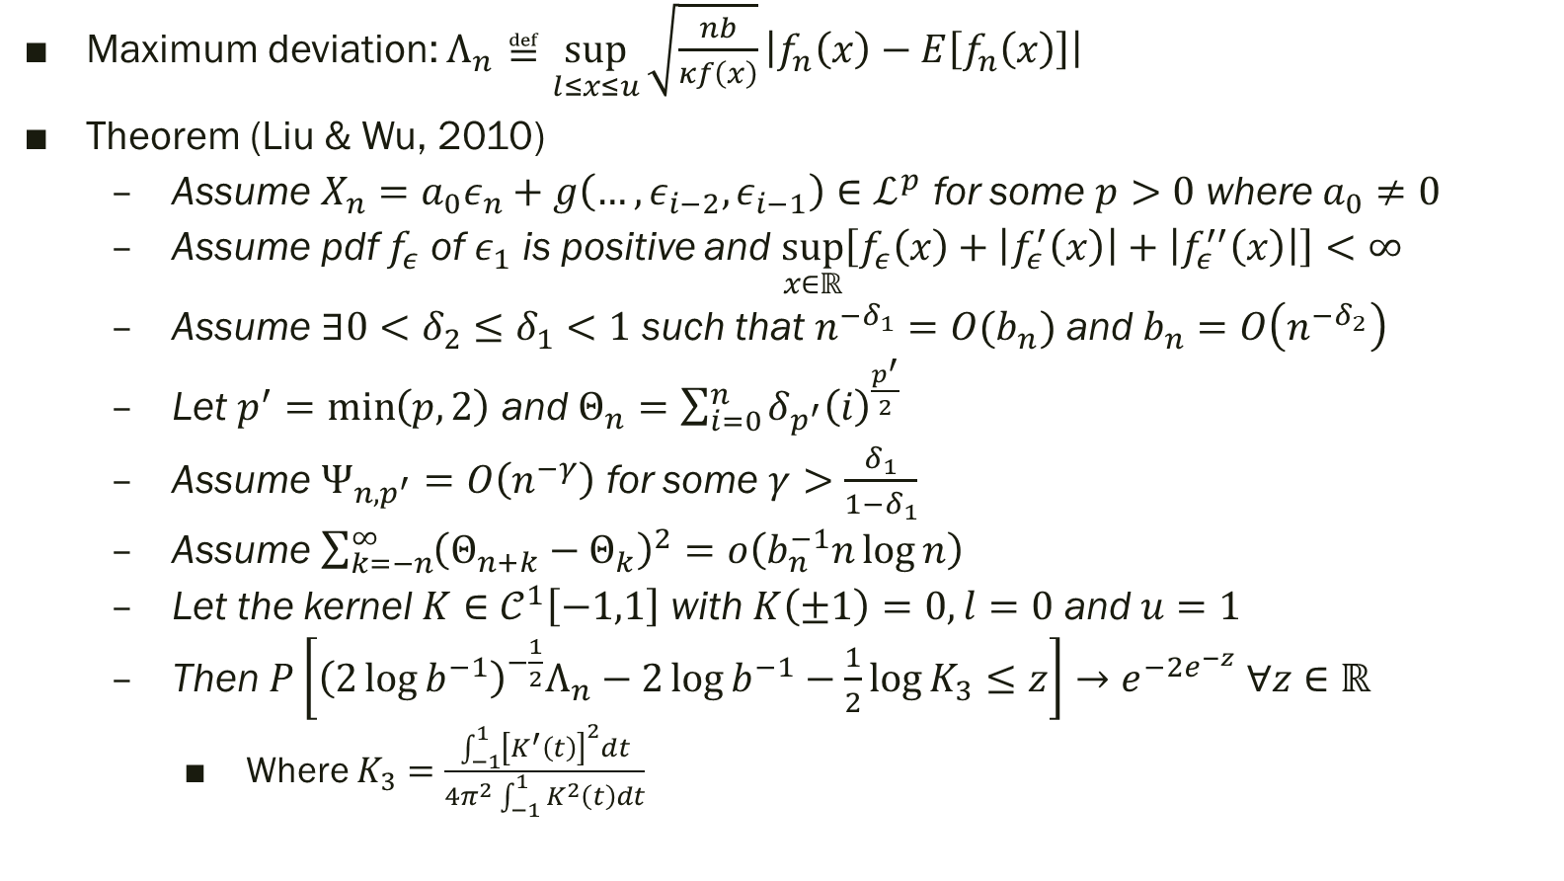
Maximum deviation
Maximum deviation: $Λ_{n}≝\sup_{l≤x≤u}{\sqrt{\frac{nb}{κf\left(x\right)}}\left|f_{n}\left(x\right)−E\left[f_{n}\left(x\right)\right]\right|}$
Theorem (Liu & Wu, 2010)
Assume $X_{n}=a_{0}ε_{n}+g\left(…,ε_{i−2},ε_{i−1}\right)∈ℒ^{p}$ for some $p>0$ where $a_{0}≠0$
Assume pdf $f_{ε}$ of $ε_{1}$ is positive and $\sup_{x∈ℝ}\left[f_{ε}\left(x\right)+\left|f_{ε}^{′}\left(x\right)\right|+\left|f_{ε}^{′′}\left(x\right)\right|\right]<∞$
Assume $∃0<δ_{2}≤δ_{1}<1$ such that $n^{−δ_{1}}=O(b_{n})$ and $b_{n}=O\left(n^{−δ_{2}}\right)$
Let $p^{′}=\min\left(p,2\right)$ and $Θ_{n}=\sum_{i=0}^{n}{δ_{p^{′}}{\left(i\right)}^{\frac{p^{′}}{2}}}$
Assume $Ψ_{n,p^{′}}=O\left(n^{−γ}\right)$ for some $γ>\frac{δ_{1}}{1−δ_{1}}$
Assume $\sum_{k=−n}^{∞}{{\left(Θ_{n+k}−Θ_{k}\right)}^{2}}=o\left(b_{n}^{−1}n\log{n}\right)$
Let the kernel $K∈𝒞^{1}\left[−1,1\right]$ with $K\left(±1\right)=0, l=0$ and $u=1$
Then $P\left[{\left(2\log{b^{−1}}\right)}^{−\frac{1}{2}}Λ_{n}−2\log{b^{−1}}−\frac{1}{2}\log{K_{3}}≤z\right]→e^{−2e^{−z}} ∀z∈ℝ$
Where $K_{3}=\frac{\int_{−1}^{1}{{\left[K^{′}\left(t\right)\right]}^{2}dt}}{4π^{2}\int_{−1}^{1}{K^{2}\left(t\right)dt}}$

Slide 53
U-statistics
Section 12

Slide 54
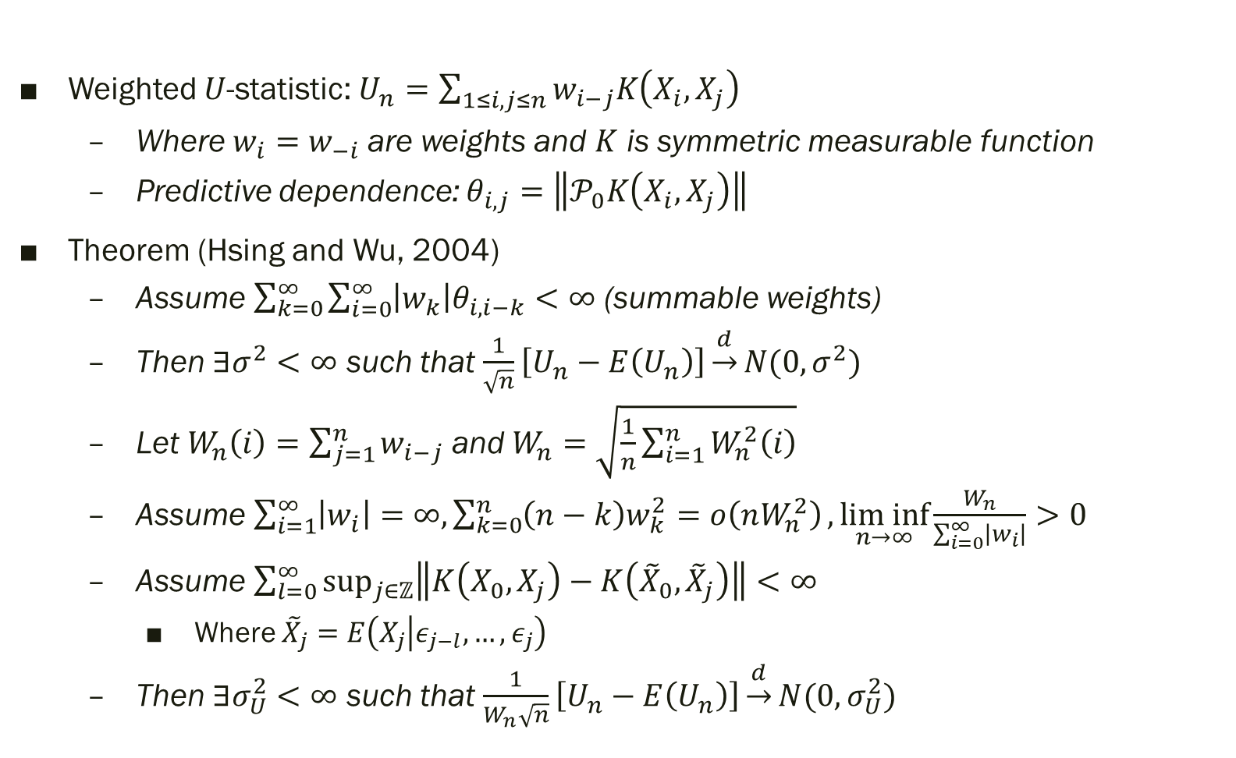
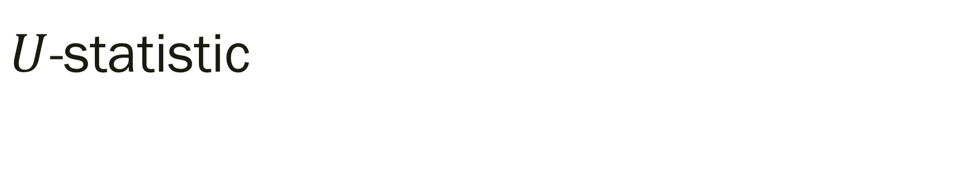
$U$-statistic
Weighted $U$-statistic: $U_{n}=\sum_{1≤i,j≤n}{w_{i−j}K\left(X_{i},X_{j}\right)}$
Where $w_{i}=w_{−i}$ are weights and $K$ is symmetric measurable function
Predictive dependence: $θ_{i,j}=\left\|𝒫_{0}K\left(X_{i},X_{j}\right)\right\|$
Theorem (Hsing and Wu, 2004)
Assume $\sum_{k=0}^{∞}{\sum_{i=0}^{∞}{\left|w_{k}\right|θ_{i,i−k}}}<∞$ (summable weights)
Then $∃σ^{2}<∞$ such that $\frac{1}{\sqrt{n}}\left[U_{n}−E\left(U_{n}\right)\right]\underset{→}{d}N(0,σ^{2})$
Let $W_{n}\left(i\right)=\sum_{j=1}^{n}{w_{i−j}}$ and $W_{n}=\sqrt{\frac{1}{n}\sum_{i=1}^{n}{W_{n}^{2}\left(i\right)}}$
Assume $\sum_{i=1}^{∞}{\left|w_{i}\right|}=∞, \sum_{k=0}^{n}{\left(n−k\right)w_{k}^{2}=o\left(nW_{n}^{2}\right)},\underset{n→∞}{lim inf}{\frac{W_{n}}{\sum_{i=0}^{∞}{\left|w_{i}\right|}}}>0$
Assume $\sum_{l=0}^{∞}{\sup_{j∈ℤ}\left\|K\left(X_{0},X_{j}\right)−K\left({\tilde{X}}_{0},{\tilde{X}}_{j}\right)\right\|}<∞$
Where ${\tilde{X}}_{j}=E\left(X_{j} | ε_{j−l},…,ε_{j}\right)$
Then $∃σ_{U}^{2}<∞$ such that $\frac{1}{W_{n}\sqrt{n}}\left[U_{n}−E\left(U_{n}\right)\right]\underset{→}{d}N(0,σ_{U}^{2})$

